Slide 1
WOMEN IN THE NAVY

Slide 2
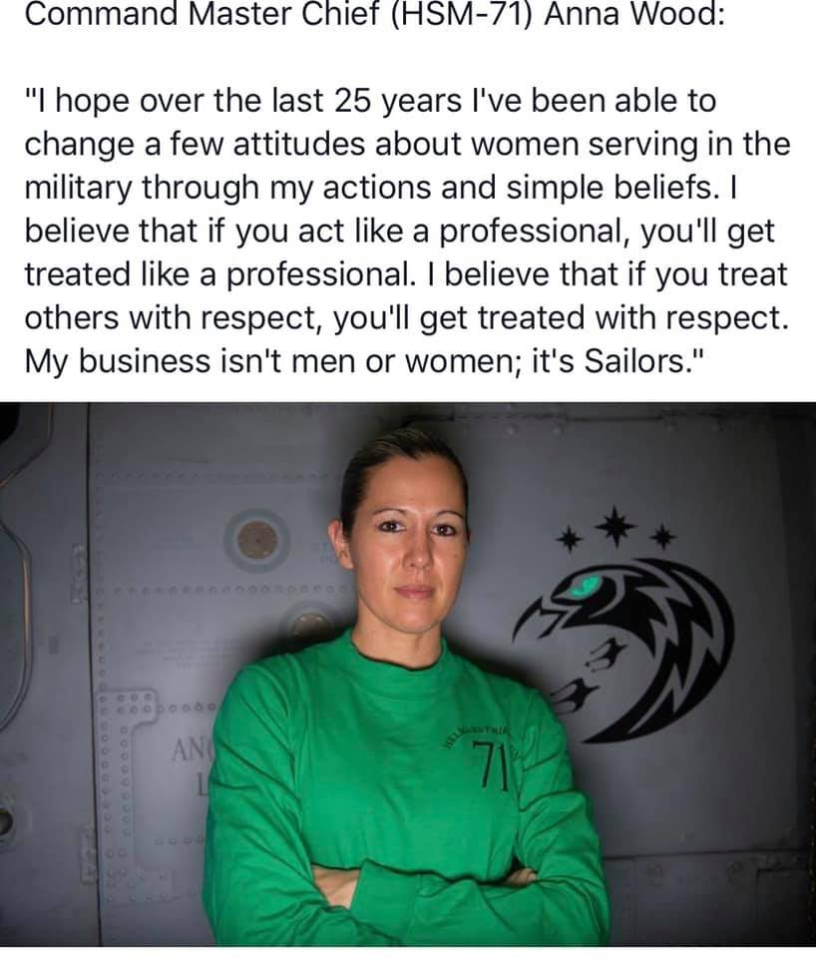
Background
Gender stereotypes are overridden in the Navy by determination, proven capabilities, and a shared appreciation for adventure, adrenaline and hard work. In America's Navy, women are trailblazers and leaders who daily defeat old school perceptions as they dominate in dozens of dynamic career fields.

Slide 3
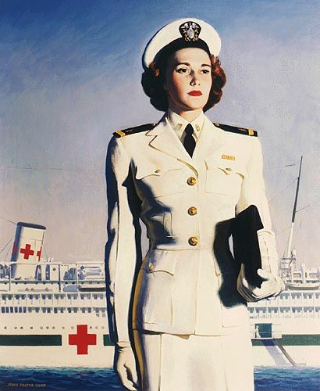
History
The first women to serve in the U.S. Navy were nurses, beginning with the “Sacred Twenty” appointed after Congress established the Navy Nurse Corps on 13 May 1908.
President Franklin D. Roosevelt signed Public Law 689 creating the Navy’s women reserve program on 30 July 1942, which paved the way for officer and enlisted women to enter the Navy.
On 22 February 1974, the Navy designated the first woman as an aviator.
On 7 March 1994, the Navy issued the first orders for women to be assigned aboard a combatant ship.
Today women serve in every field that America’s Navy has to offer.
In March 2016 America’s Navy opened the Seal program to Women.

Slide 4
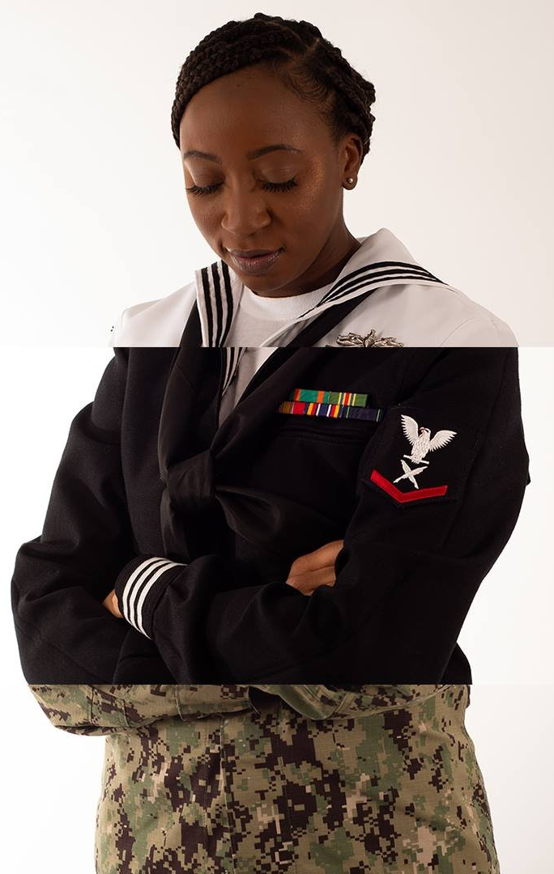
Uniforms
Women in the Navy wear many hats, fill many shoes and wear any uniform. You can be any combination of hero in the Navy.
Uniform modernization is an ongoing project. The maternity uniforms, undershirts and, other items are consistently updated.
Earrings, rings, bracelets, necklaces are authorized to be worn in uniform.

Slide 5
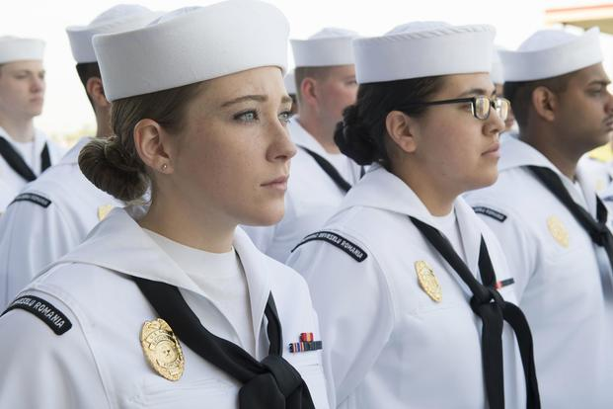
Hair Regulations
The Navy is the most lenient branch when it comes to hair regulations.
Just recently we approved multiple different hairstyles to include braids, larger buns and, ponytails while in uniform.
We will also not cut your hair in basic training! Prior to departing we will teach you the proper way to style your hair in bootcamp.

Slide 6
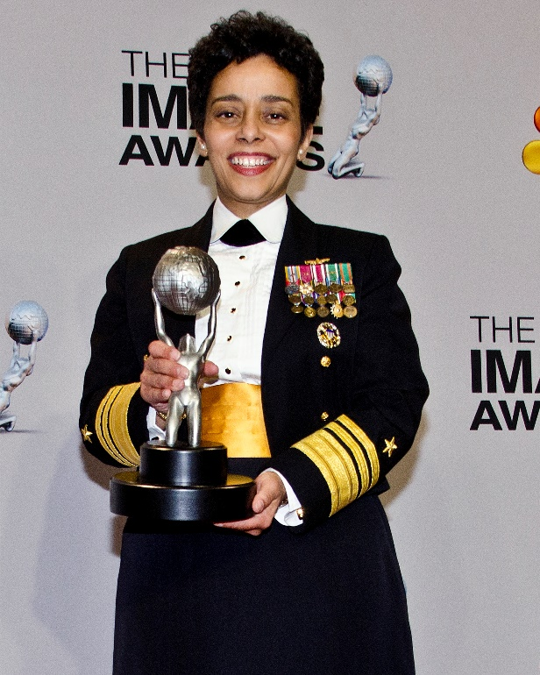
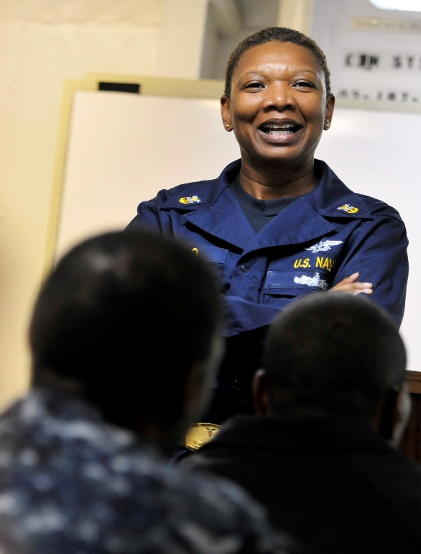
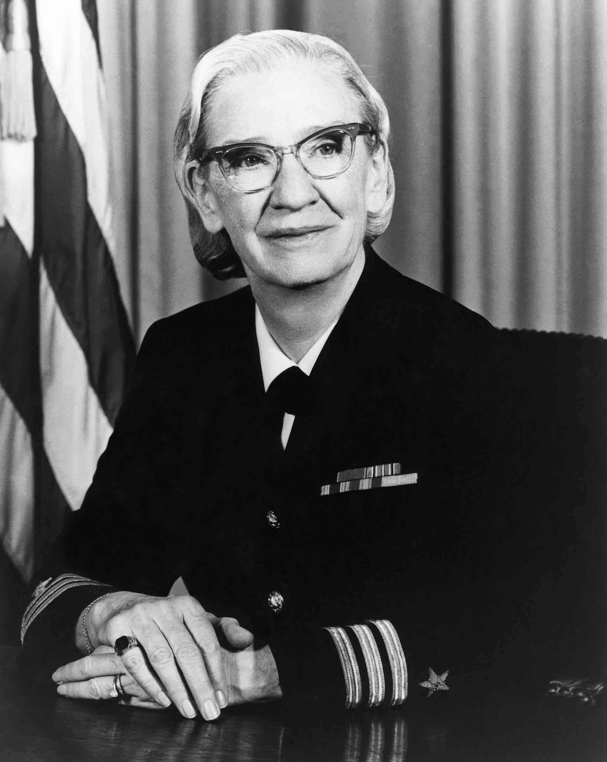
Notable Women
Admiral Howard was the first female 4 star.
First African American and Woman to hold post as Vice CNO.
Fleet Master Chief Beldo of MPT&E.
Over 34 years of service to Country.
Admiral Hopper coined the phrase “Debugging”.
Launched the Navy into the technology era.

Slide 7
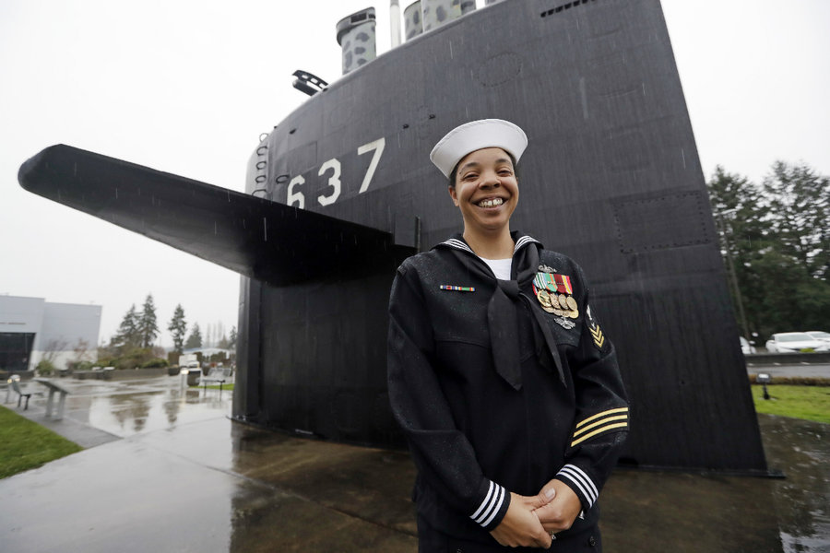
Growing Fields
Apart from Special Warfare the Navy has opened up Submarine duty assignments.
April 29th 2010 Navy authorized females to begin submariner pipeline.
On December 5th 2012 the Navy qualified its first 3 Female Sailors in Submarines.

Slide 8
Questions?

