Slide 1
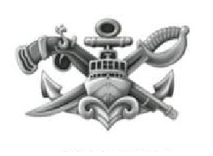
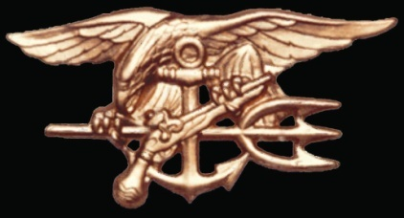
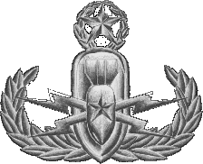
Warrior Challenge Program NAVAL SPECIAL WARFARE
NAVAL SPECIAL OPERATIONS

Slide 2
PST MINIMUM STANDARD vs. DRAFT
 | SEAL | SWCC | AIRR | EOD | DIVER
500 Yd Swim | 12:30 ~9:30 | 13:00/ ~9:30 | 12:00/ ~9:30 | 12:30/ ~9:30 | 12:30/ ~9:30
Push-ups | 50/~75 | 50/~75 | 42/~75 | 50/~75 | 50/~75
Sit-ups | 50/~75 | 50/~75 | 50/~75 | 50/~75 | 50/~75
Pull-ups | 10/~15 | 6/ ~15 | 4/~15 | 6/~15 | 6/~15
1.5 Mile Run | 10:30/ ~9:30 | 12:00/ ~9:30 | 12:00/ ~9:30 | 12:30/ ~9:30 | 12:30/ ~9:30
Minimum scores won’t compete in “DRAFT”

Slide 3
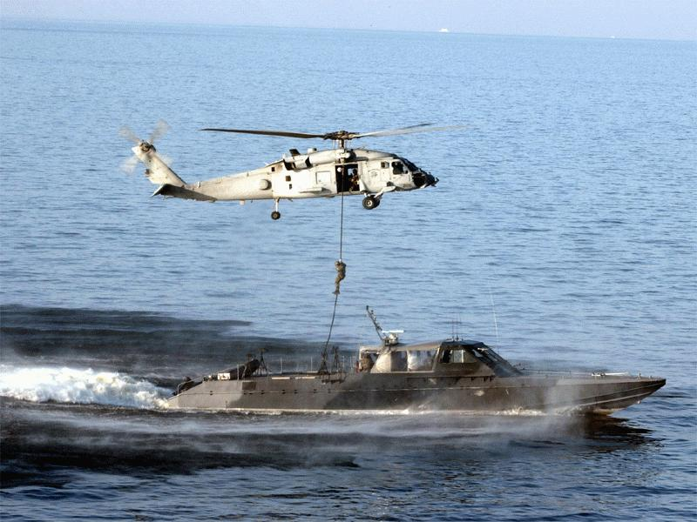
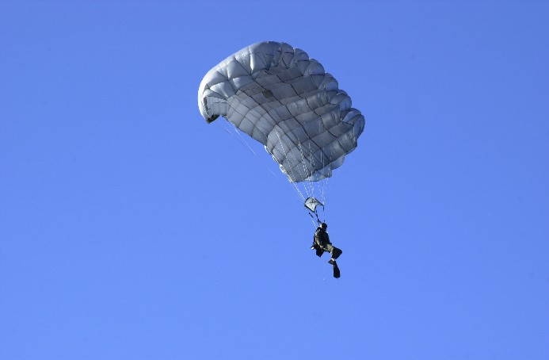
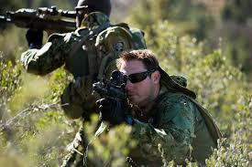
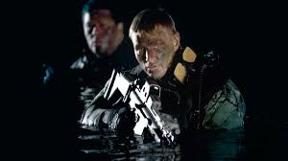
US NAVY SEALS
Conduct direct action, reconnaissance and engagement/FID missions from, on, under, or over the Sea, Air and Land. Training never ends, combat skills are constantly honed. Failure is not an option!

Slide 4
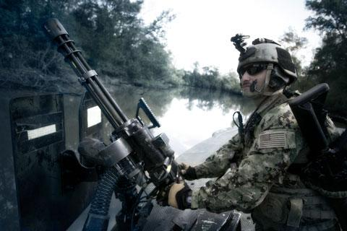
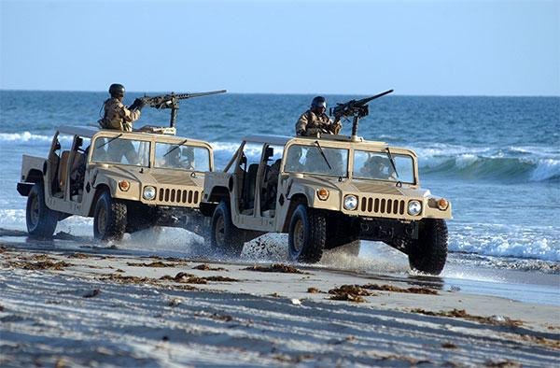
Special Warfare Combatant-craft Crewman(SWCC)
Special Warfare Combatant-craft Crewman(SWCC) Operate Naval Special Warfare’s high-speed, assault craft with emphasis on stealth and overwhelming combat fire power in Coastal, Riverine, Open ocean, and Over land operations. SWCC also conduct direct action, reconnaissance, FID, and counter narcotics missions. Training never ends, combat skills are constantly honed. Failure is not an option!

Slide 5
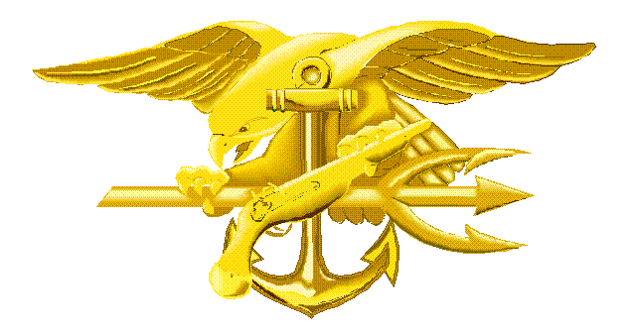
SEAL (SO) Development Total Timeline
NSWCEN ATC
NSW GROUP Training
DEPLOY
NSWCEN
NSWCEN BTC/ATC
NTCNSW
PREP
8 wks
Unit Level Training
Squadron Integration Training
BUD/S
PARA/SERE/SQT
PRODEV
Orientation 3 wks
21 wks
26 wks
4-6 mos.
4-6 mos.
4-6 mos.
2 + years of training until 1st SOF deployment

Slide 6
SWCC (SB) Development Total Timeline
1 year of selection + x2 Work ups (4 years) + 1 year in TRNG = 6 year contract
1 yr. +RTC
SBT 12/20/22
NSWCEN
NSWCEN BTC/ATC
TRNG
BCS
-Selection
-”Gut Check”
-Tour
PARA/SERE/CQT
-Small and heavy weps
-Small Unit Tactics
-Sea & Land Navigation
-Medical
-Maritime Ops
NTCNSW
PREP
8 wks
Unit Level Training
Squadron Integration Training
PRODEV
Deploy
Orientation 3 wks
8 wks
28 wks
6 m
6 m
6 m
6 m
x2
- SHOOT - MOVE - COMMUNICATE -
2 + years of training until 1st SOF deployment

Slide 7
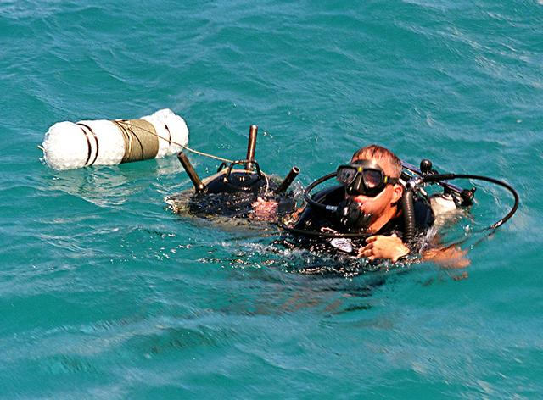
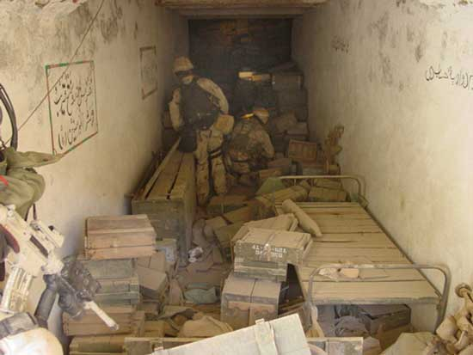
EOD Technicians:
Members of the Navy’s elite/tactical bomb squad
Deploy world wide
Integrate with Marine Expeditionary Forces, Army Special Forces and NSW
Eliminate explosive threats on land and sea
Open to both men and women

Slide 8
Explosive Ordnance Disposal Training
EOD Preparation training
NTC, Great Lakes, IL, 5 weeks
EOD Dive course
NDSTC, Panama City FL, 9 weeks
Diving physics, open/closed circuit SCUBA, small boat operations
EOD Training
Joint EOD Center, Eglin AFB, FL, 42 weeks
Explosive demolitions, EOD tools and methods, chemical, BIO, nuclear munitions and render safe procedures
Graduate…assigned to EOD Mobile Units CONUS/OCONUS

Slide 9
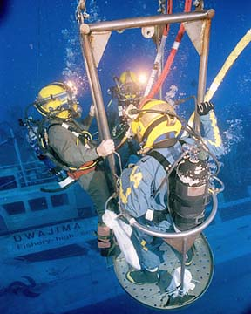
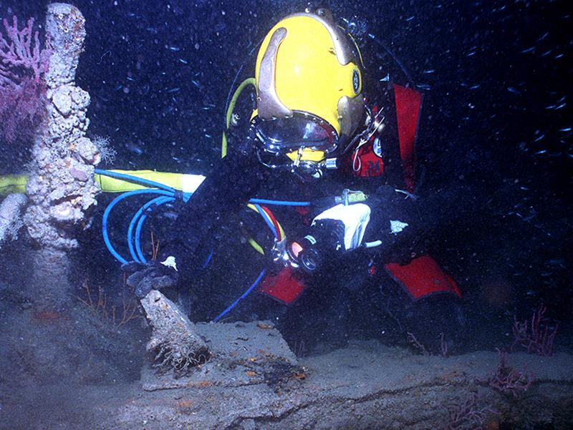
Navy Deep Sea Divers Salvage Experts
If lost underwater…they find it
If sunk…they raise it
If in the way…they move it
Diving and salvage operations worldwide in support of our Navy and Special Operations
Open to both men and women.

Slide 10
Deep Sea Diver Training
Diving Preparation training
NTC, Great Lakes, IL, 5 weeks
Physical conditioning, aquatics drills/competency
Second Class Dive School
NDSTC, Panama City, FL, 14 weeks
Diving physics/medicine, surface-supplied air and scuba diving techniques, underwater tools, work, repair, cutting, welding techniques, search and salvage procedures
Second class Divers assigned to:
Mobile Dive Salvage Units, Ship Repairs, EOD and SEAL Teams

Slide 11
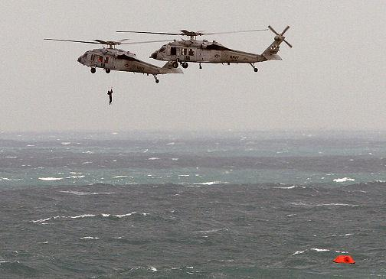
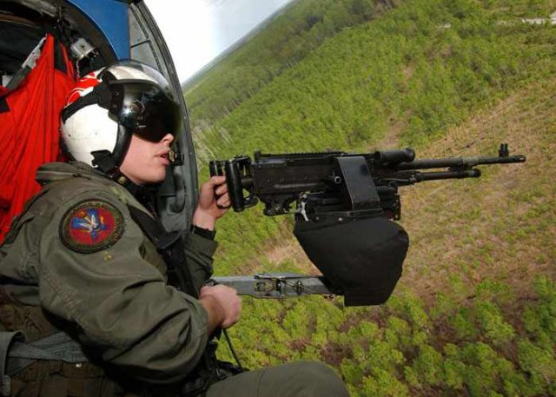
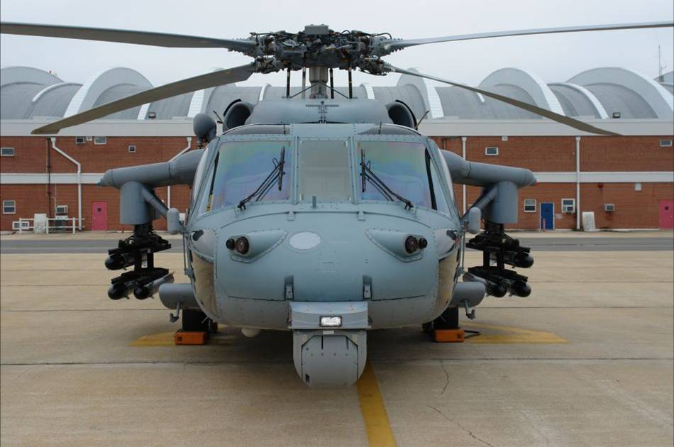
Helicopter Rescue Swimmers (AIRR) are vital to the Navy Search and Rescue mission. Conduct world-wide operations including: Combat Search and Rescue (CSAR), Disaster relief, open ocean and overland rescue operations, NSW/NSO support operations, troop/cargo transport and drug interdiction. Swimmers MUST be in top physical performance and willing to risk their lives to save the life of another in both combat and peacetime environments.
AW Helicopter Rescue Swimmer – AIRR

Slide 12
AW Helicopter Rescue Swimmer – AIRR
Naval Aircrew Candidate School (NACCS) Pensacola, FL.
Four week COI
Physical conditioning, aviation adaptability, water competency,
teamwork and mental tenacity.
Aviation Rescue Swimmer School (ARSS) Pensacola, FL.
Five week COI
Demands higher levels of physical fitness and swimming proficiency
Trains Rescue Swimmer for open ocean and inland rescue operations, including advanced lifesaving medical training
Follow on training: AW ‘A’ school, SERE and Helicopter specific training.
Assigned to Helicopter Squadrons CONUS and OCONUS

Slide 13
NSW/NSO PROFILE
Aquatically adaptable!
Physically fit, mature, highly motivated, self starter, goal setter, achievement oriented, driven…
Creative, forward thinking, looking to do something different
I want to…
be part of something bigger than myself
be physically and mentally challenged…every day
perform under high stress/high risk conditions
Understand the challenges/demands of a long, specialized and tactical/technical training pipeline
Use WEB R-Tools to identify potential NSW-NSO candidates!
What are you looking for……where are you looking?
Athletes: Swimmers, Wrestlers, Runners, Soccer, Football, Water polo, etc…
Notes:
CNSWC 03 responsible for updating this slide.
TRANSITION: As these next few slides will show, NSW is uniquely qualified to be the preemptive force needed to defeat terrorists because we are versatile, responsive, offensively focused, and continuously forward deployed to take the fight to the enemy
Humans are more important than hardware, and Naval Special Warfare operators are among the best-trained forces in the world.
Naval Special Warfare’s most important weapon will always be the SEAL and SWCC operator. The strength of the NSW community is the people. Even with sophisticated technologies, “eyes on target” provides the most reliable intelligence and positive identification (PID) of the enemy.
NSW operators are elite warriors. They are mature and highly educated. The average age of our operator is 27 years old and the majority of our SEALs and SWCCs have college degrees. All NSW operators have a career commitment to education.
NSW operators are smart, fit, mature, and hardworking young men from all races and backgrounds. They are extremely well trained and prepared. SEAL operators spend more than 2 years in training before they deploy into SEAL units, while SWCCs train for more than one year before joining NSW Special Boat Teams. Every operator possesses the tactical skills, advanced technologies and unconventional mindset to succeed against any adversary.
When presented with intelligence that is perishable, our force must have the ability and authority to take decisive action against our enemies, to prevent them from planning and carrying out terrorist actions. Our NSW Squadrons deploy with senior officer and enlisted leaders to ensure the best possible decisions are made. We are highly dependable and disciplined professionals with uncompromising integrity and judgment under stress. We can be trusted with highly sensitive and dangerous missions.

Slide 14
USEFUL WEBSITES
Official NSW/NSO websites
www.sealswcc.com
www.eod.navy.mil

