Slide 1
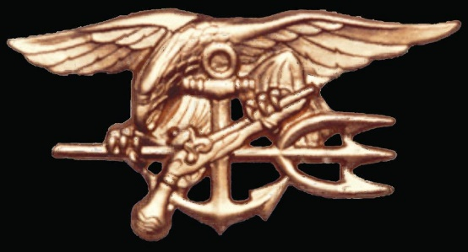
NAVAL SPECIAL WARFARE
NAVAL SPECIAL OPERATIONS
AIR RESCUE

Slide 2
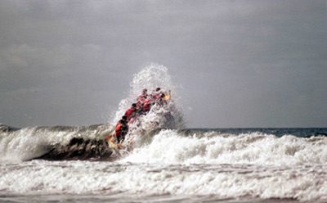
U.S. NAVY SEALS

Slide 3
“The Only Easy Day was Yesterday” Basic Underwater Demolition / SEAL training (BUD/S)
2 years of the most demanding training in the US military
Bootcamp/SEAL PREP
16 WEEKS ( 8 weeks each)
BUD/S - 7 months
Basic Conditioning Phase
Diving (SCUBA, LAR V)
Land Warfare
SQT - 4 months
Further refinement of skills learned in BUD/S
Pre-deployment - 12-18 months
Platoon and specific training

Slide 4
SEAL Mission
Conduct world-wide non-conventional missions supporting the Global War on Terror
Conduct reconnaissance, direct action and a variety counter terrorism missions on land and sea
War Fighting skills include: diving, demolition, weapons (small arms and heavy weapons), parachuting, combatant “hand-to-hand” fighting, offensive/defensive vehicle driving, and much more!

Slide 5
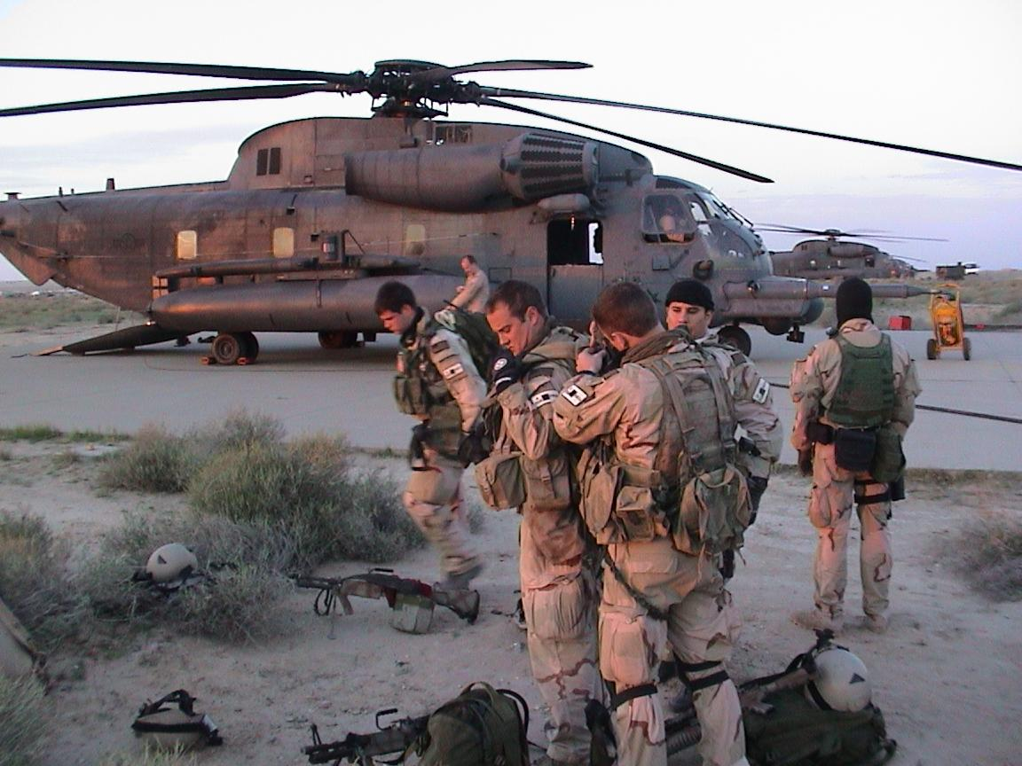
Quality of Life
The highest Paid enlisted men in the military
Enlistment Bonus $12,000 and advancement to E-4 upon graduation from BUD/S and SQT.
Re-enlistment Bonus up to $100,000(Based off SRD Zones)
Specialty pays over $900 per month. Additional pays for foreign language qualification and SEAL Delivery Vehicle (SDV) SEALs.

Slide 6
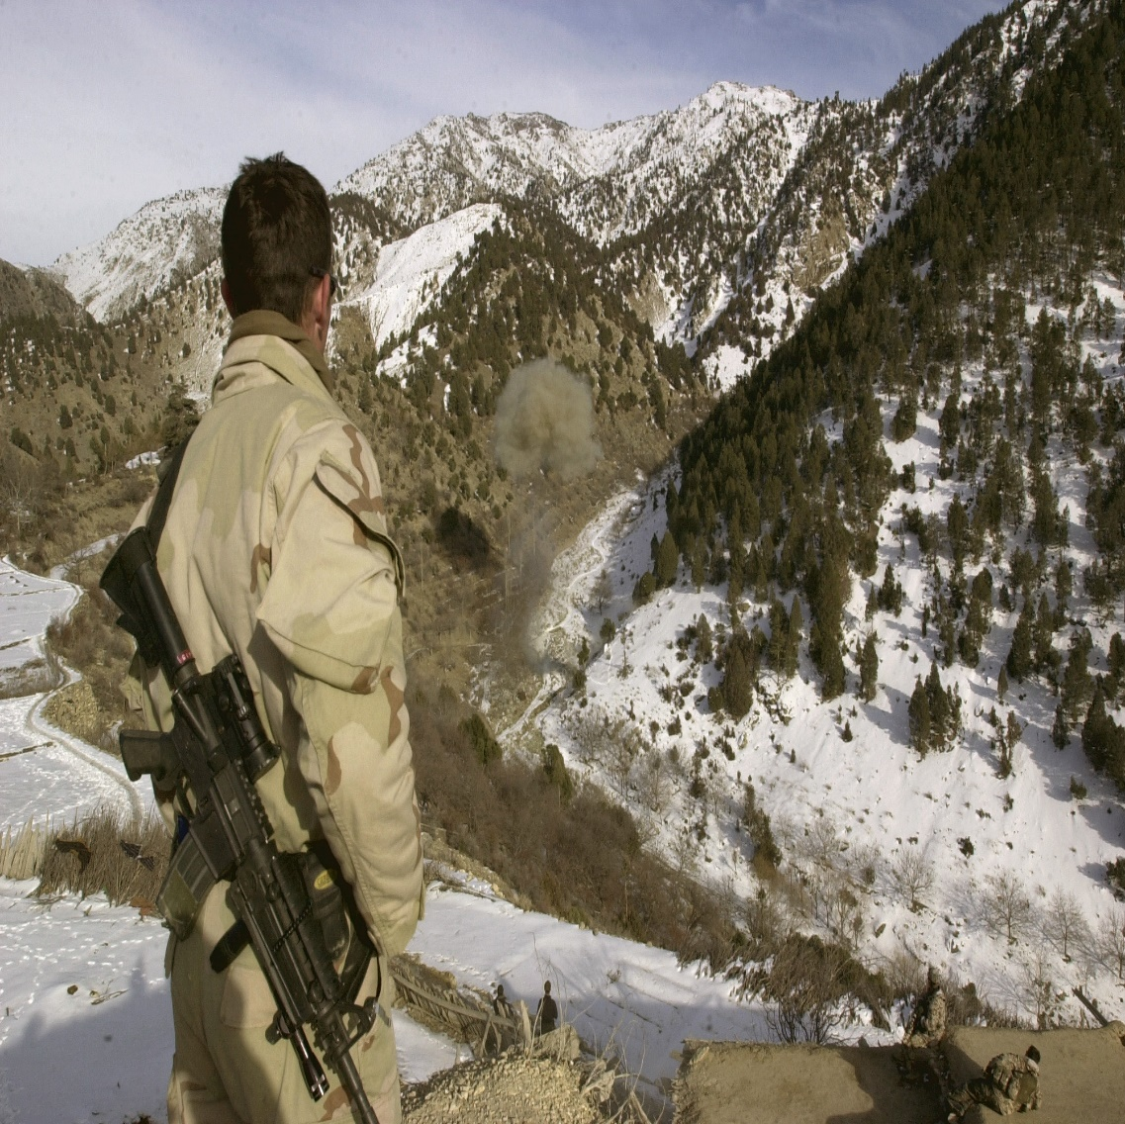
“Be Someone Special”
U.S. Navy SEALs are today’s most effective weapon in the Global War on Terrorism
Unconventional Mindset:
We cultivate awareness and creative thinking under high stress/ high risk
Do you want to fight terrorism with Good training, or the best training?

Slide 7
General Qualifications
BE A CITIZEN OF THE UNITED STATES
BE BETWEEN 17-28 YEARS OF AGE
LINE SCORE QUALIFY ON THE ASVAB
PASS A STANDARD MILITARY PHYSICAL AT A MEPS
HAVE NORMAL COLOR PERCEPTION
BE ABLE TO QUALIFY FOR A SECURITY CLEARANCE
EYESIGHT NO WORSE THAN 20/70 AND MUST BE CORRECTABLE TO 20/25
BE ABLE TO PASS A PRE-SCREENING TEST COMPRISING A 500 YARD SWIM, PUSH-UPS, SIT-UPS, PULL-UPS AND A MILE AN A HALF RUN. ALL MUST BE COMPLETED WITH PRESCIBED TIME LIMITS

Slide 8
SPECIAL WARFARE COMBATANT-CRAFT CREWMAN
(SWCC)

Slide 9
SWCC MISSION
Direct Action, Special Reconnaissance, Foreign Internal Defense, Unconventional Warfare, Combating Terrorism, Combat Drug Activities, and Combat Search and Rescue.
Insert/extract SEAL and other Special Operations forces in a maritime environment
Operate, navigate, and maintain a variety of Special Operations Maritime craft
Conduct maritime interdiction operations
Conduct maritime water parachute insertions of personnel and Special Operations Craft Deploy worldwide in support of Special Operations missions

Slide 10
SWCC
Basic Crewman Training (BCT), Coronado, CA.
Eleven week course (to include three weeks of indoc)
Focus on physical conditioning, small boat seamanship, water competency, teamwork, and mental tenacity.
Weekly conditioning runs, pool/open water swims, and obstacle courses.
Crewman Qualification Training (CQT), Coronado, CA.
21 week course
Qualifies SWCC candidates in basic weapons, seamanship, first aid, and special boat tactics, with emphasis on maritime navigation, communications, waterborne patrolling techniques, marksmanship, and special boat engineering.

Slide 11
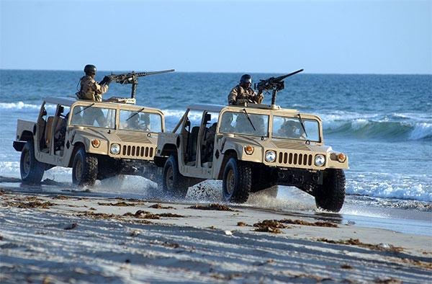
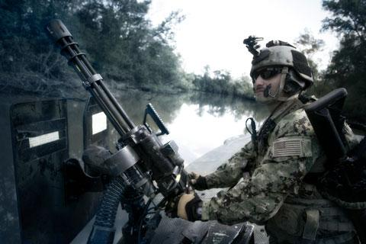
SWCC
Special Warfare Combatant-craft Crewman(SWCC) operate Naval Special Warfare’s high-speed, assault craft with emphasis on stealth and overwhelming combat fire power in coastal, in and around a riverine environment and the open ocean. SWCCs are Expert Heavy weapons Gunners and Maritime Operators. On Time! On Target! Never Quit!

Slide 12
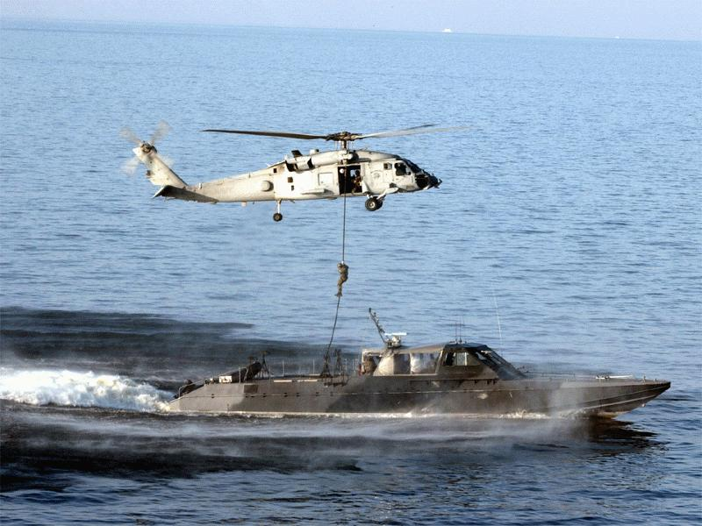
BENEFITS
Enlistment bonuses of
$8,000 and up, with advancement to E-4 upon completion of the SWCC pipeline.
Reenlistment bonus up to $100,000 (Based off SRB Zones).
Specialty pays up to $900+ per month
Operator Mindset! Utilizing the strongest muscle in the body to overcome any obstacle, The Brain.

Slide 13
GENERAL QUALIFICATIONS
Be a citizen of the united states
Be between 17-30 years of age
Line score qualify on the asvab
Pass a standard military physical at a meps
Have normal color perception
Be able to qualify for a security clearance
Eyesight no worse than 20/70 and must be
Correctable to 20/25
Be able to pass a pre-screening test comprising a 500 yard swim, push-ups, sit-ups, pull-ups and a mile an a half run. All must be completed with prescibed time limits

Slide 14
Explosive Ordinance Disposal

Slide 15
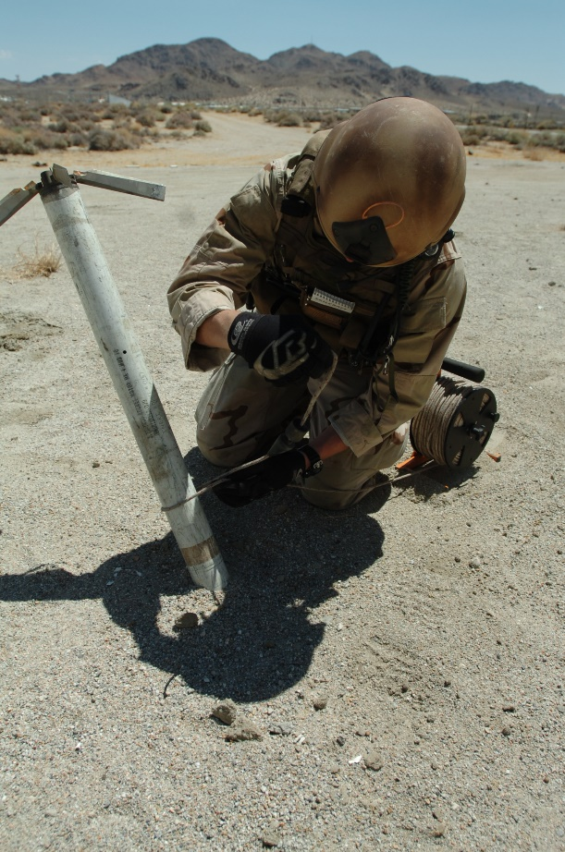
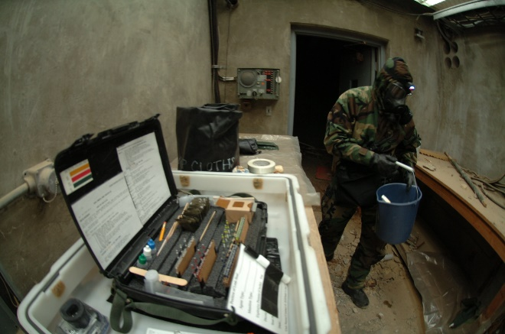
NAVY EOD MISSION
Serve as ordinance technical experts to the fleet
Disarm and render safe all types ordinance to include:
Conventional Ordinance
Improvised Explosive Devises (IED’s)
Chemical/Biological/Nuclear devises
Underwater ordinance (torpedoes or mines)
Provide EOD support to Navy SEALs, Army Special Forces, Marine Expeditionary Forces
Marine Mammal Systems
Provide EOD Support to Government Agencies, specifically,
Secret Service
FBI
CIA
NCIS

Slide 16
NAVY EOD TRAINING
NTC (2 weeks Prep. COI)
12 days 2nd Class Dive School preparation.
-Physical training
-Water familiarization
-Classroom
NDSTC EOD Dive School(8 weeks)
SCUBA
MK 16 Closed Circuit Rebreather.
**COI qualifies a member to 190 feet.
Naval School Explosive Ordinance Disposal- (38 Weeks)
EOD Core knowledge
Demolition
Ground Ordinance
Air Ordinance
NAVSCOLEOD (cont)
Chemical/Biological
Improvised Explosive Devises
Nuclear/Radiological
Underwater Ordinance
Army Basic Airborne (3 weeks)
Basic static-line jump school
Navy EOD Tactical Training
Land navigation
Combat First Aid
Tactical shooting
Tactical radio communications

Slide 17
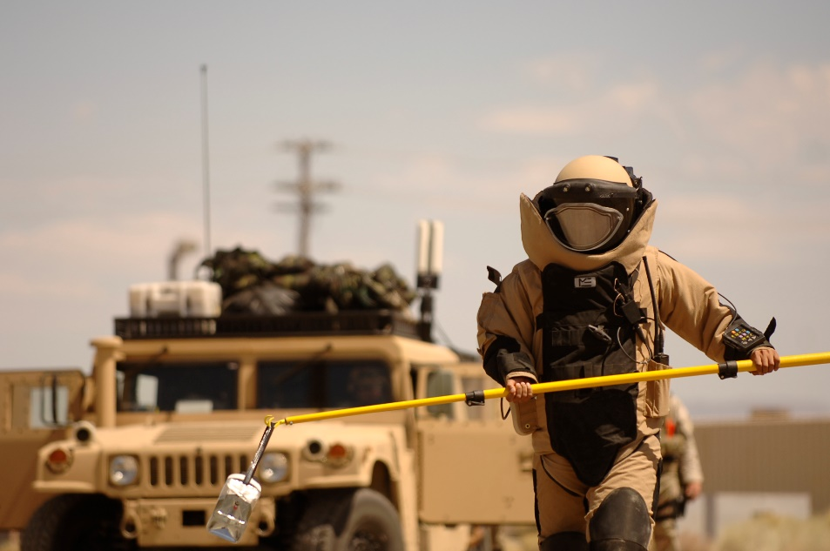
NAVY EOD COMMANDS
EOD Mobile Units
2 East Coast
2 West Coast
2 Over Seas (Guam & Italy)
EOD Shore commands throughout US and over seas
EOD Technical Division at Indian Head MD.
Various Joint Task Force Units
Research and development commands

Slide 18
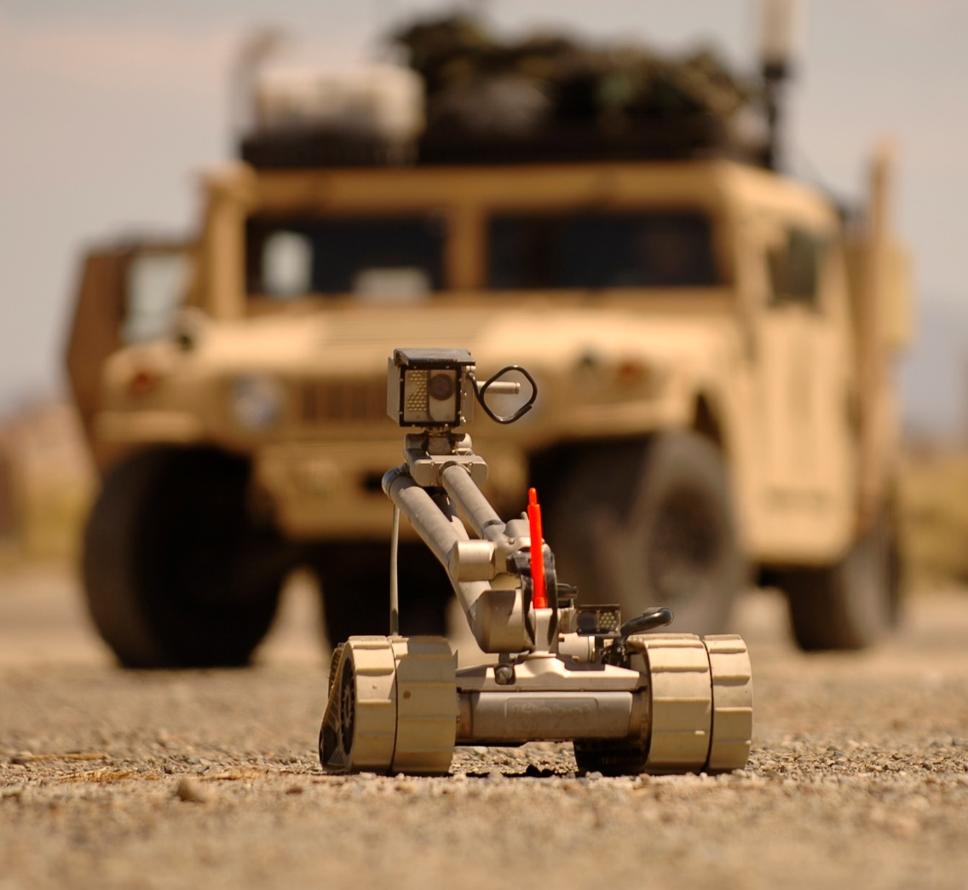
BENEFITS
Enlistment bonus
$8,000 and advancement to E-4 upon completion of Basic EOD School.
Reenlistment bonus up to $90,000 (Based off SRD Zones).
Specialty pays up to $750 per month
Rewarding career for both men and women.

Slide 19
GENERAL QUALIFICATIONS
BE A CITIZEN OF THE UNITED STATES
BE BETWEEN 17-30 YEARS OF AGE
LINE SCORE QUALIFY ON THE ASVAB
PASS A STANDARD MILITARY PHYSICAL AT A MEPS
HAVE NORMAL COLOR PERCEPTION.
BE ABLE TO QUALIFY FOR A SECURITY CLEARANCE
EYESIGHT NO WORSE THAN 20/200 AND MUST BE
CORRECTABLE TO 20/25
BE ABLE TO PASS A PRE-SCREENING TEST COMPRISING A 500 YARD SWIM, PUSH-UPS, SIT-UPS, PULL-UPS AND A MILE AN A HALF RUN. ALL MUST BE COMPLETED WITH PRESCIBED TIMELIMITS

Slide 21
NAVY DIVER MISSION
Perform Underwater (U/W) Salvage
U/W demolition
U/W ships maintenance and repair
Search and rescue
U/W construction
Combat Salvage
Recompression operations
Technical experts for SEAL EOD and USMC commands
Conduct SDV operations
Supports military and civilian law enforcement agencies
Perform Hyperbaric O2 Therapy in conjunction with Navy Medicine

Slide 22
NAVY DIVER TRAINING
PREP COURSE
(Great Lakes, IL)
20 days to include basic knowledge of electrical and mechanical engineering.
12 days 2nd Class Dive School preparation.
-Physical training
-Water familiarization
-Classroom
2ND Class Dive School
(Panama City, FL)
Dive medicine
SCUBA
Surface supplied apparatus
Surface supplied systems
Special Operations apparatus
UW tools and work techniques
UW cutting/welding
Training qualifies a member to dive to 190 feet.

Slide 23
NAVY DIVER COMMANDS
Mobile Diving and Salvage Units.
Ships Maintenance Centers-(Perform underwater repairs on ships)
SEAL/USMC Command- (Diving technical experts)
EOD Command- (Diving technical experts)
Research and development commands

Slide 24
BENEFITS
Enlistment bonus
$8,000 and advancement to E-4 upon graduation from Second Class Dive School.

Slide 25
Reenlistment bonus over $45,000 (Based off SRB Zones).
BENEFITS
Specialty pays up to $500 per month
Rewarding career for both men and women.

Slide 26
GENERAL QUALIFICATIONS
BE A CITIZEN OF THE UNITED STATES
BE BETWEEN 17-30 YEARS OF AGE
LINE SCORE QUALIFY ON THE ASVAB
PASS A STANDARD MILITARY PHYSICAL AT A MEPS
HAVE NORMAL COLOR PERCEPTION. SOME WAIVERS DO APPLY.
BE ABLE TO QUALIFY FOR A SECURITY CLEARANCE
EYESIGHT NO WORSE THAN 20/200 AND MUST BE
CORRECTABLE TO 20/25
BE ABLE TO PASS A PRE-SCREENING TEST COMPRISING A 500YARD SWIM, PUSH-UPS, SIT-UPS, PULL-UPS AND A MILE AN A HALF RUN. ALL MUST BE COMPLETED WITH PRESCIBED TIMELIMITS

Slide 27
AVIATION RESCUE SWIMMER

Slide 28
RESCUE SWIMMER MISSION
Search & Rescue
Naval Special Warfare Support
Anti-Submarine Warfare
Medical Evacuations
Drug Interdiction
Logistics Support
Humanitarian Mission Support

Slide 29
RESCUE SWIMMER TRAINING
Naval Aircrewman Candidate School 1 Month
Aviation Rescue Swimmer Course 1 Month Applicable “A” School 2-4 Months
Survival Evasion Resistance Escape (SERE) 2 weeks
Fleet Replacement Squadron 4-8 Months

Slide 30
RESCUE SWIMMER BENEFITS
$8,000 Enlistment Bonus and
automatic advancement to E-4
upon completion of “A” school.
Specialty pays of up to $400 per month.
Rewarding career for both men and women

Slide 31
GENERAL QUALIFICATIONS
BE A CITIZEN OF THE UNITED STATES
BE BETWEEN 17-30 YEARS OF AGE
LINE SCORE QUALIFY ON THE ASVAB
PASS A STANDARD MILITARY PHYSICAL AT A MEPS
HAVE NORMAL COLOR PERCEPTION.
BE ABLE TO QUALIFY FOR A SECURITY CLEARANCE
EYESIGHT NO WORSE THAN 20/200 AND MUST BE
CORRECTABLE TO 20/20
BE ABLE TO PASS A PRE-SCREENING TEST COMPRISING A 500 YARD SWIM, PUSH-UPS, SIT-UPS, PULL-UPS AND A MILE AN A HALF RUN. ALL MUST BE COMPLETED WITH PRESCIBED TIME LIMITS

Slide 32
PRE-SCREENING TEST REQUIREMENTS
PST EVENT | SEAL | SWCC | EOD & DIVER | SAR
500 Yard Swim SEAL Combat S/S | 12:30 | 13:00 | 12:30 | 12:00
10 Min Rest
Continuous Push ups for 2 minutes | 50 | 50 | 50 | 42
2 Min Rest
Continuous Sit ups for 2 Min | 50 | 50 | 50 | 50
2 Min rest
Dead Hang Pull Ups | 10 | 6 | 6 | 4
10 Min Rest
1.5 Mile Run | 10:30 | 12:00 | 12:30 | 12:00

Slide 33
A CAREER IN THE NAVY’S SPECIAL WARFARE AND SPECIAL OPERATIONS FORCES
A career in these programs offers unique opportunities and experiences for highly motivated people who are seeking challenges in their lives.
ARE YOU THAT PERSON?

Slide 34
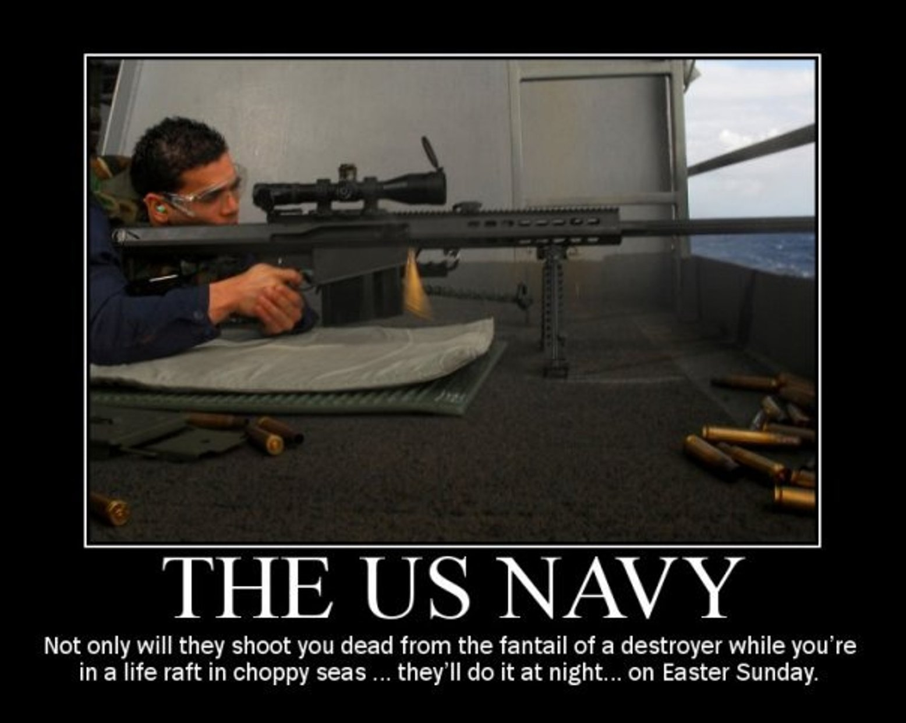

Slide 35
QUESTIONS?

