Slide 1
NUCLEAR POWER
Notes:
Good afternoon! My name is Petty Officer _________ with the United States Navy. Today we are going to be diving into how boiling water can create enough energy to move a air craft carrier or submarine across the world!

Slide 2
Do you have what it takes?
Must graduate from high school.
Must be a United States citizen.
Have completed at minimum 1 year Algebra 1.
Good grades in Math and Science.
Limited civil involvement.
Limited financial issues.
Score very well on the ASVAB.
Pass a complete medical physical with no color blindness.

Slide 3
Navy Nuclear Power Program
Enter at a pay grade of E-3 - two pay grades higher than everyone else coming in.
Currently has a $38,000.00 sign on bonus with re-enlistment bonuses of up to $100,000.00 (can be done multiple times)
Paid to go to school rather than paying to go to school.
Upon graduation from Nuclear Field “A” School you are advanced to paygrade of E-4.
Receive 70-90 ACE accredited college credits for completion of training.
College degree completely paid for using TA or GI Bill

Slide 4
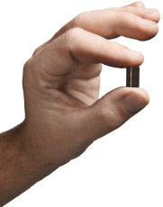
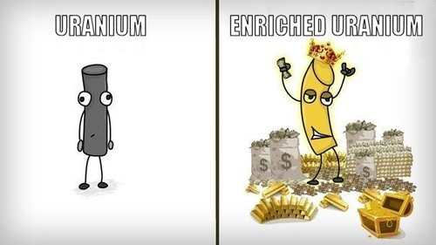
Why Are We Interested In Nuclear Power?
There is a LOT of energy contained in atoms!
Fissioning 1 gram of Uranium-235 produces 24,000 kW-hr of energy.
This is the same as burning 3 tons of coal, or 12 barrels of oil (378 gal), or 50,000 ft³ of natural gas
How long can 1 lb. of Coal light a 100 watt light bulb?
Approximately 9 hours
How long can 1 lb. of Uranium light the same bulb?
3000 years!!!
Notes:
Who hear has ever heard the word Nuclear?.... Raising your hand, what are some thoughts or images that usually come up in your heads? We’ve all watched some type of movie speaking of uranium or some type of radioactive metal being stolen, the reason why is because its instability, if harnessed correctly, can create energy!

Slide 5
How Does a Nuclear Reactor Create Electricity?
Boil Water!
Produce heat (via fission)
Use heat to boil water into steam
Use steam to turn a turbine-generator
This is the same as:
Solar thermal plants
Natural gas plants
Coal power plants
Oil power plants

Slide 6
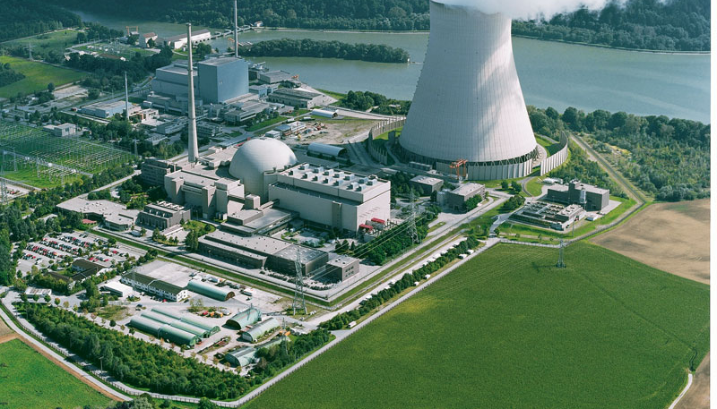
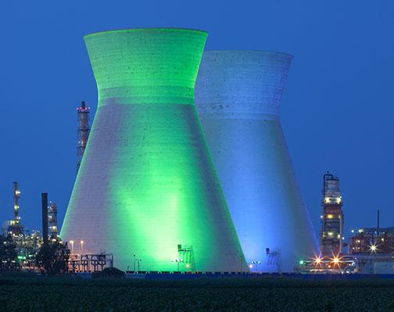
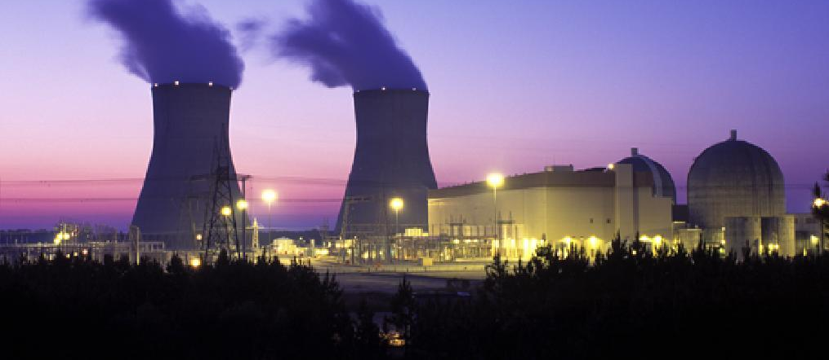
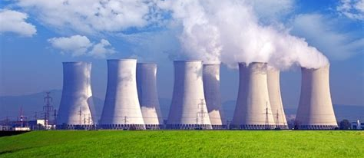
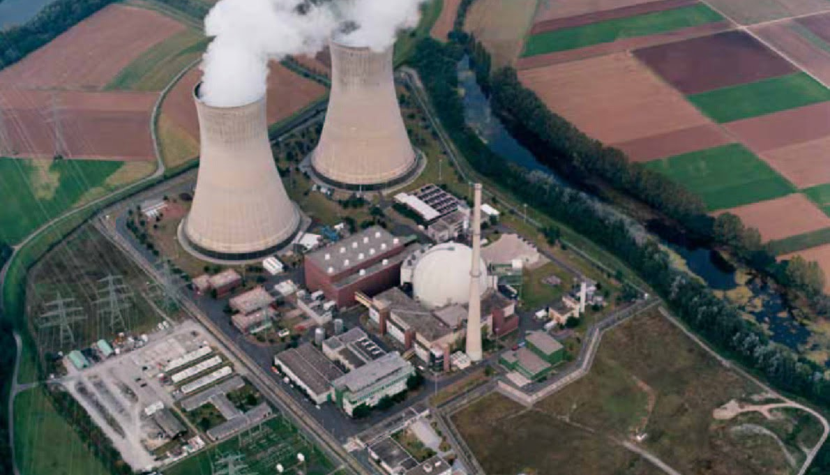
Notes:
Today we’re going to talk about how the Nuclear Power Propulsion Operator program or just joining the Navy can help you achieve numerous accomplishments that a lot of you are searching for. Financial freedom, the ability to speak about adventures you’ll experience, countries you have travelled to, training you have acquired through the navy, perks of being on a military installation and surrounding cities, education obtained without sitting in a college auditorium, and how the navy can make you feel successful. All while providing stability and fun that a lot of fortune 500 companies cannot offer you.

Slide 7
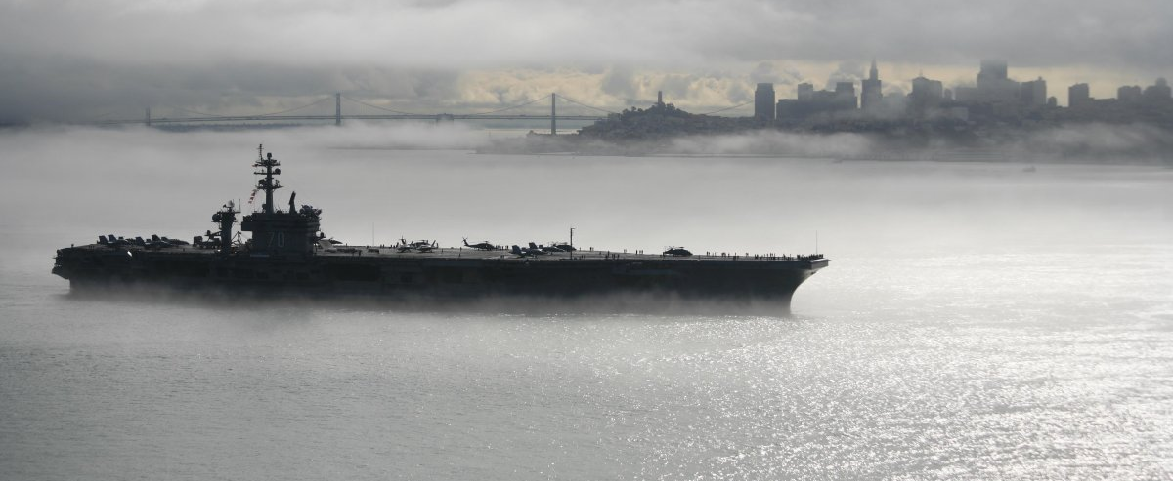
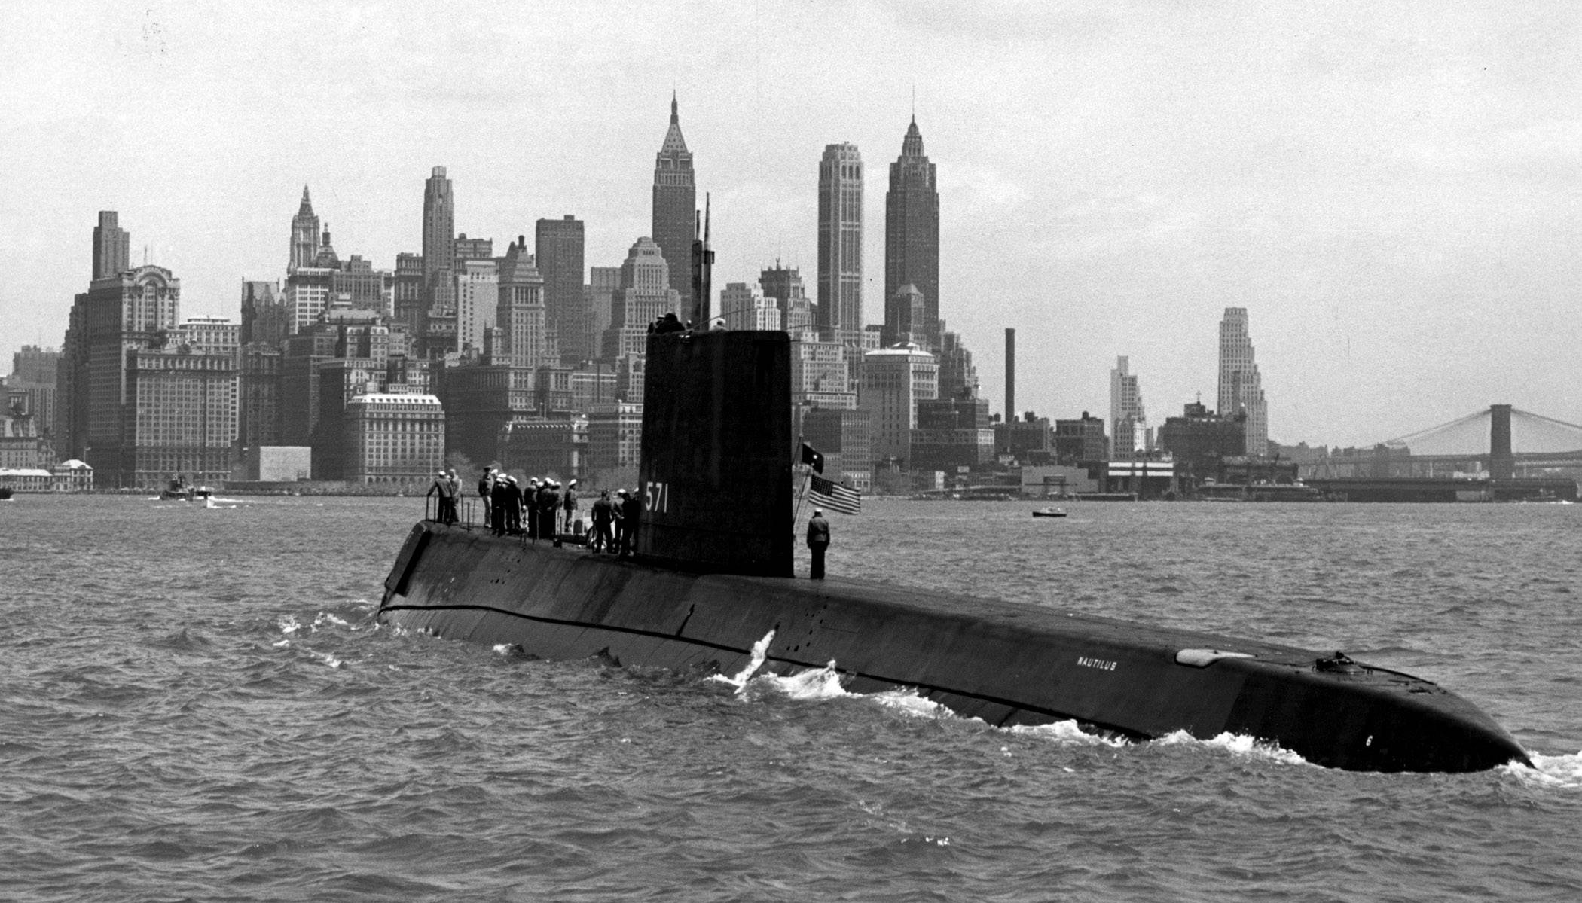
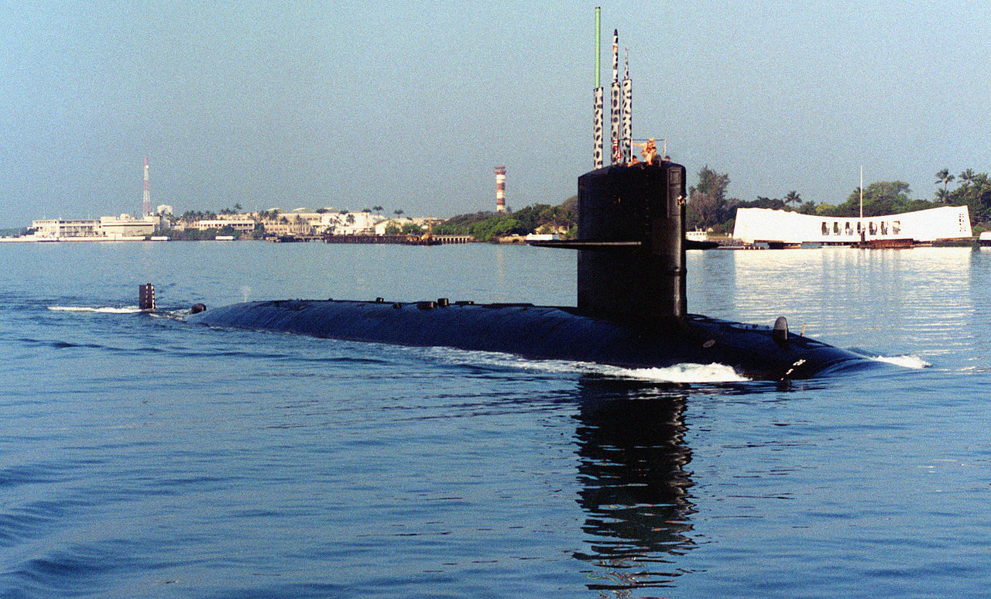
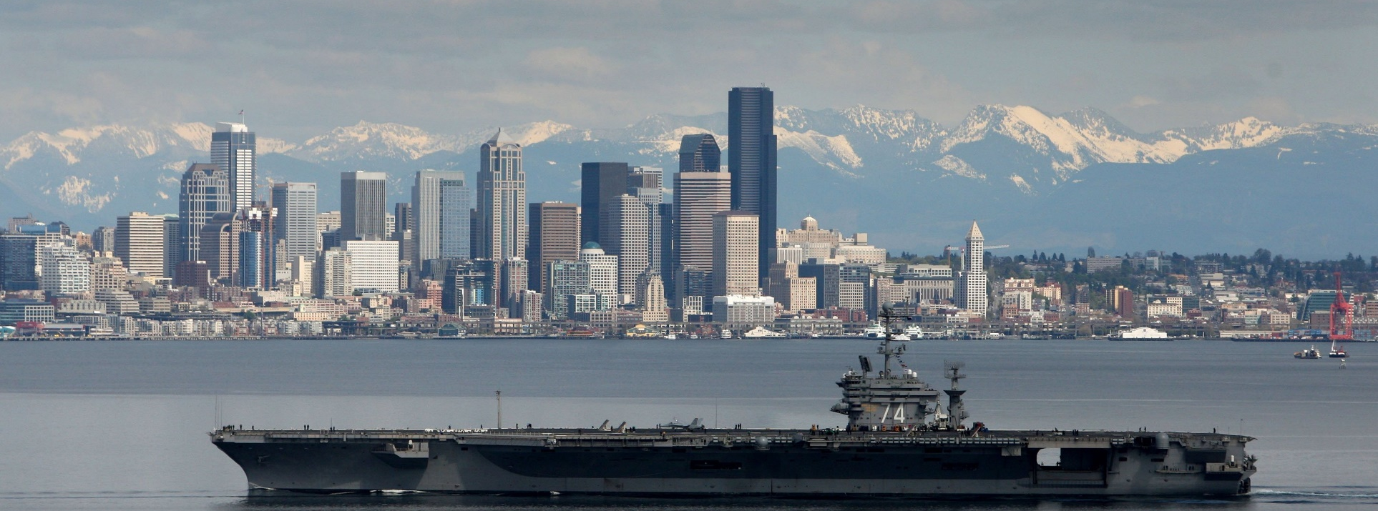
Notes:
Money: Through this Nuclear Power Propulsion program you are promoted to the rank of E3 before ever attending any type of training. You’re given a promotion before ever lifting a finger to work. Through this program you can actually be promoted 2 additional ranks, but you’ll have to talk to me after this presentation to find out how. Think about it, most enlistees come in at the pay grade of E1, you come in at E3. That means you are higher ranking, but you also have higher responsibility and held to a higher standard. If you can get a head start in life, why not take it. It’s an additional 18 months for an enlistee to go from E1-> E3

Slide 8
Nuclear Career Outlook
Real median household income in the US is $61,372 (2017, U.S. Census Bureau)
About 33.4% of Americans 25 and over have a college degree (2017, U.S. Census Bureau)
Average starting salary for a 2018 college grad is about $50,390 (2018, Korn Ferry)
Median salary 10 years after enrolling at MIT is $91,600 (2016, Business Insider)
Average starting salary range for Navy Nuke transitioning out of navy $90,000-$150,000 (2018, Navy Nuke Job Finder) and even more with degree!

Slide 9
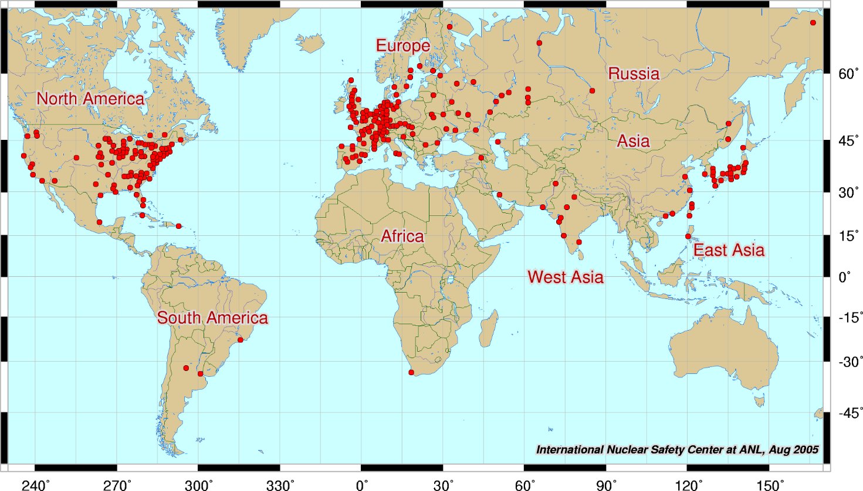
Nuclear Power Plants Around the World
Notes:
Adventure: This is a map of where all the nuclear power plants are located in the world, but I also want to use this as a visual aid. If qualified and selected for this program, you fall into a very selective group of personnel who are able to go onto an aircraft carrier or submarine. These ships go on cruises that will take you around the world where you will create some of the greatest memories you will ever have. You’ll come back home comparing what we call sea stories about riding elephants, climbing Mt. Fuji, and feeding Tigers halfway across the world. I always made sure to bring back something for my family, so I made sure everywhere I went, I brought back different classes of chocolate to give to my siblings.

Slide 10
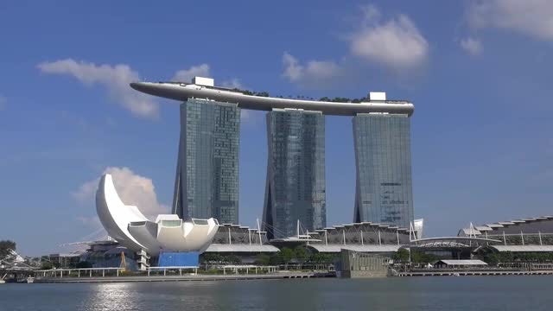
Notes:
Travel/ Recreation: As a passenger on an Aircraft carrier or submarine, your ID card is your passport. No long waits to renew or obtain a passport. Some of the countries I’ve visited are Dubai, Singapore, Thailand, Philippines, Hong Kong, Spain, and Italy. Along with chocolate for my family members I also make sure I kept their currency in a little box of mine to show my grandkids in the future. Im earning a paycheck for this the entire time.
Recreation: A show of hands who likes to play basketball, baseball, racquetball, go kayaking, or just go camping? Every navy installation will have a local MWR (morale, welfare, and recreation) office who provides equipment and ticket discounts on the things I just talked about. They offer kayaks with life vests, tents with sleeping bags, even bikes with full head and fall protection for those who forgot how to ride a bike. Our bases tend to have more than 1 gym with 2 basketball courts, a workout facility with treadmills, full sets of workout equipment, and a room designated for cardio classes.

Slide 11
The Different Jobs
Machinist Mate – Operate and maintain all machinery in the plant on both the primary and secondary side.
Electricians Mate – Manage electrical distribution system and operate and maintain all electrical equipment in the plant on both the primary and secondary side.
Electronics Technicians– Operate the reactor and maintain all circuitry involved with the reactor functionality and protection.
Notes:
Training: Through the NF program, you’ll receive training on a curriculum designed by MIT. Through on the job training you’ll be given the opportunity to first learn the curriculum then you’ll be given an opportunity to apply the principles in a real life setting with instructors who are graduates from Division I schools. True subject matter experts in the Nuclear field! They’ll create trouble shooting codes for you to diagnose and other situations to make sure you are fully capable once you graduate and can perform the job confidently.

Slide 12
Navy Nuclear Power Program
The Most Advanced Technical Training Program Offered in the Military!
Notes:
Education: The Nuclear Power Propulsion program isn’t easy. Its actually the toughest academic program across all military platforms! I want you guys to take something into perspective for me and imagine this. Stanford, Harvard, and Yale, they are considered some of the world’s most prestigious programs. If I gave you a full ride, meaning full tuition, room and board. Would you take it? In a heartbeat, right? Well this NF program is the same concept. If it was easy, everyone would be doing it. You are a student for the first 2 years to solely focus on obtaining qualifications and being educated on nuclear power. Also, these 2 years count towards your enlistment contract obligation. And one thing this program provides that a full ride cannot, is you are earning a check with full medical and dental benefits!

Slide 13
What The School Is Like
Located in Charleston, SC
3 Levels of School
Nuclear Field “A” School (Technical School), 4-6 Months
Nuclear Power School, 6 Months
Nuclear Prototype Training, 6 Months
Class from about 7:00am-3:00pm
Fast paced courses.
Instructor assistance until about 9:00pm.
Weekends and evenings free to do what you want.
Curriculum designed by MIT.
Take college level Math, Physics, Chemistry, Thermodynamics and Nuclear Engineering courses.
Notes:
Education (cont): With all the classes and credits obtained by attending the NF program. Depending on your specialty 70-90 ACE accredited college credits will be awarded for your training. That’s a junior in college without stepping foot onto a campus! All you have to do to get your bachelor’s is take your (joint service transcript) JST and give it to the counselor at the school you’re attending and you’ll start out as a Junior the first day you sit an actual college. Head starts in life, are a great feeling especially when you know how much it can benefit you.

Slide 14
39th President of the U.S.A Jimmy Carter
In Office: 1977-1981
U.S. Navy Nuke
“Next to my parents, the Navy nuclear power program had the greatest effect on my life.”
Notes:
Success: I have the picture of one of our presidents up here because I wanted to talk to you about success. This program will not get you to become a president but In the Navy I’ve grown so much. The ability to experience advancement of paygrade after paygrade is a feeling like no other. Imagine being promoted 3 times before the age of 21, how many upper classmen do you see still working at a fast food restaurant or a local grocery store. The navy has a roadmap providing guidelines on how you can promote quickly through the ranks. Responsibility increases with rank, you learn at a very young age to lead people who may be older than you and that’s a trait some people never get in their lives. We also have monthly and quarterly awards to recognize some of the outstanding things a sailor might achieve during their time attached to a certain command. No good deed goes unnoticed!

Slide 15
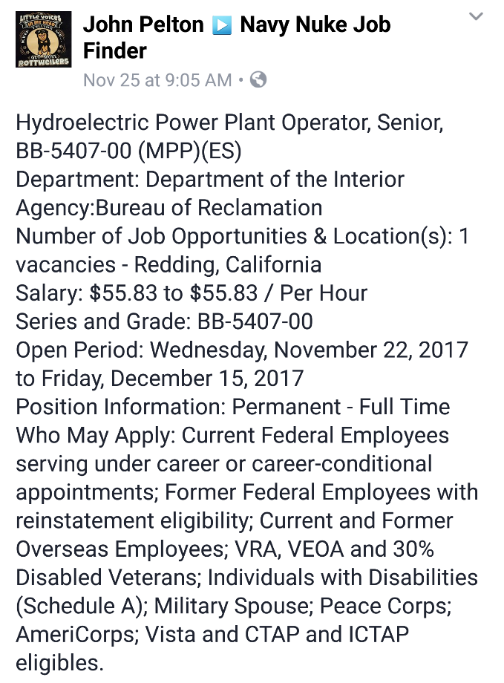
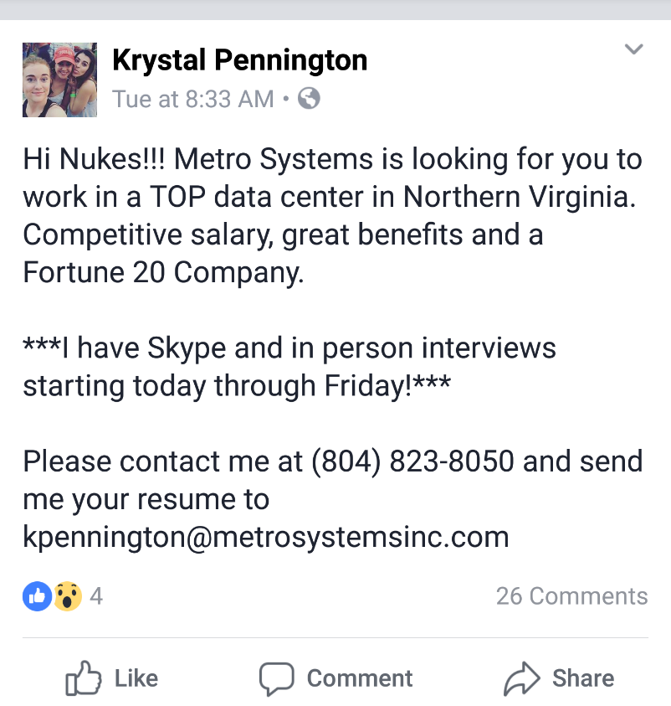
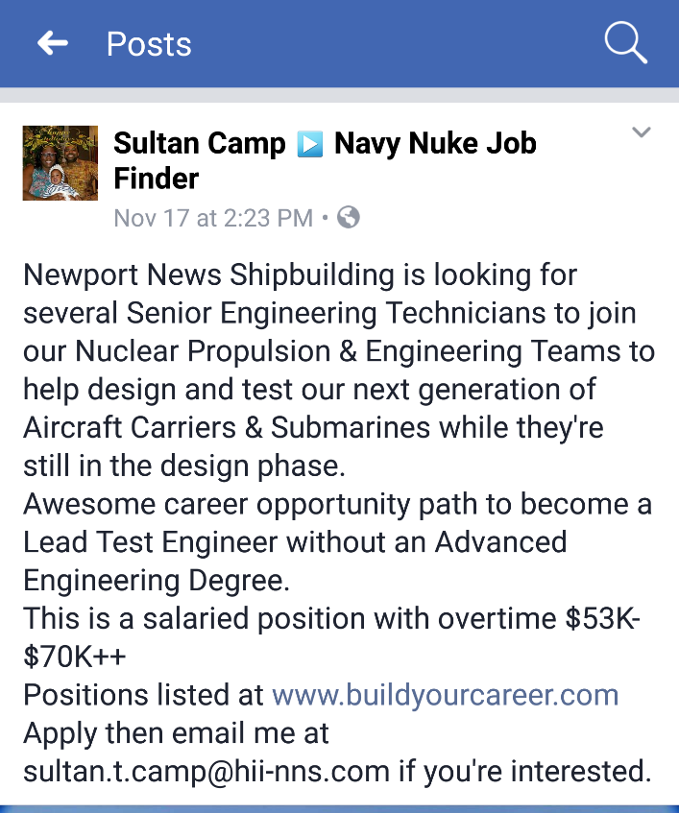
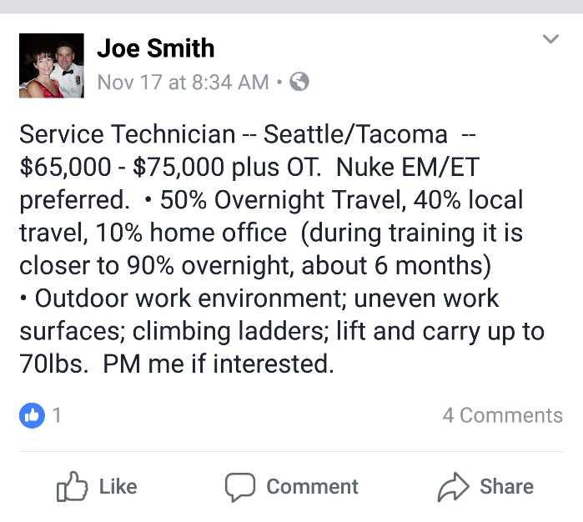
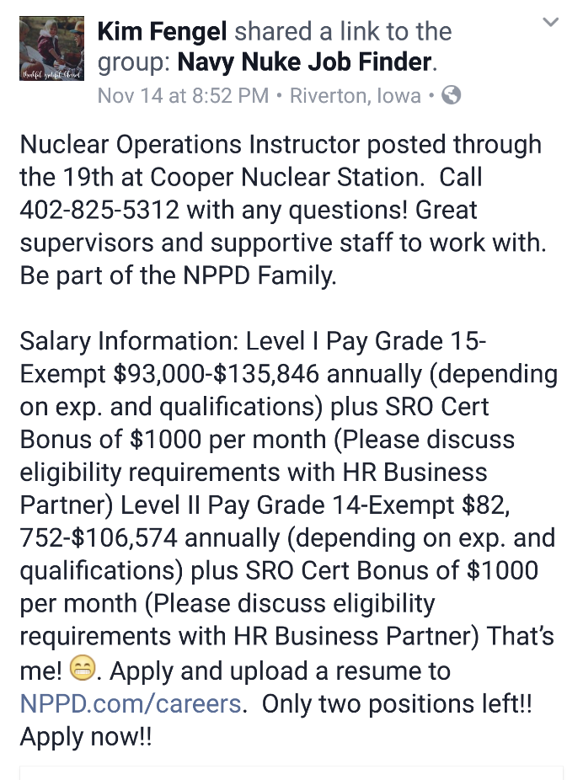
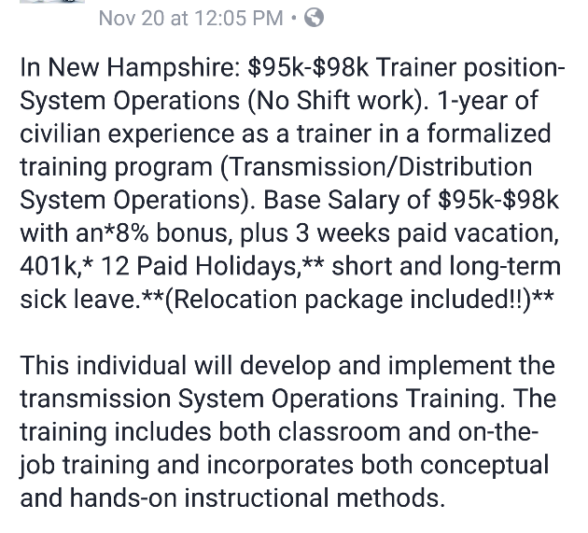
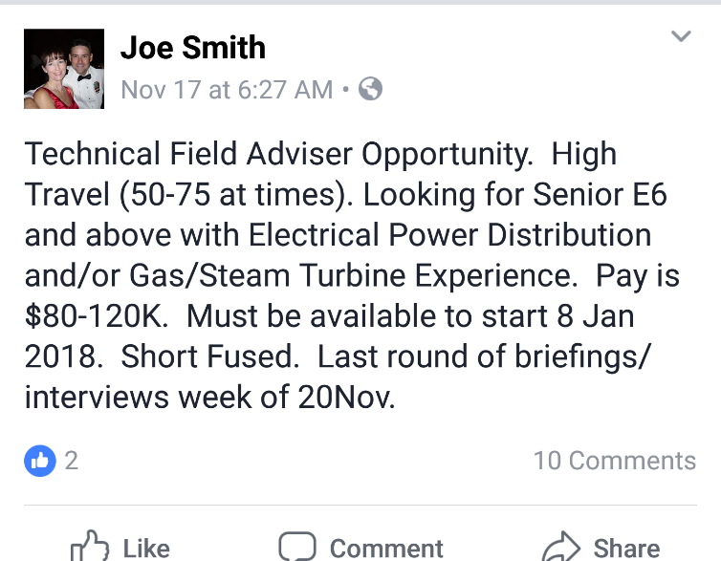
Opportunities After The Navy
Notes:
Security: There's a certain stability the Navy can provide that no other company can. We have no cutbacks or layoffs, we offer full retirement packages after 20 years of service and even have a retirement system you can invest into should you decide to leave the Navy earlier. Medical and dental is also free in comparison to a civilian who on average pays 300-500 for a family of 3 and this doesn’t include copays. These are everyday stressors a lot of students are not concerned with because society grooms you to think you must go to college after high school, otherwise success will be an afterthought. I can make success a reality!

Slide 16
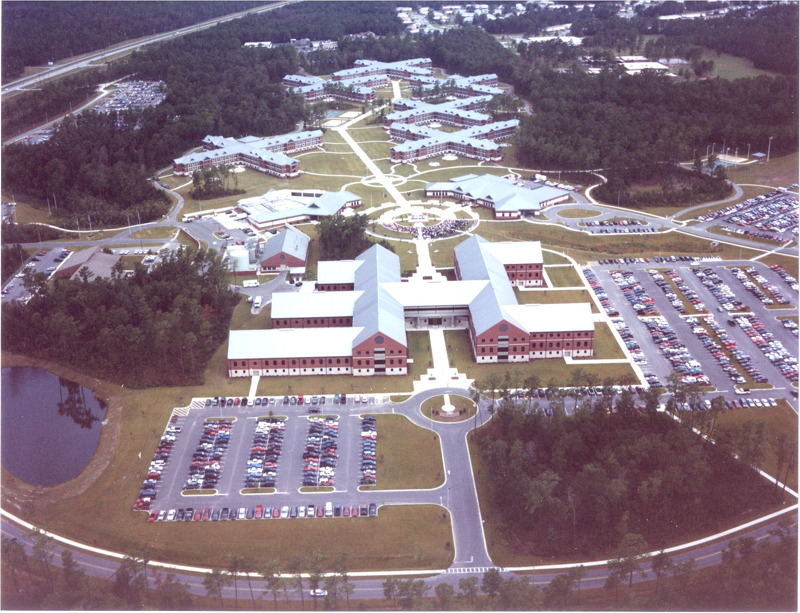
NUCLEAR POWER SCHOOL
Notes:
Power School

