Slide 1
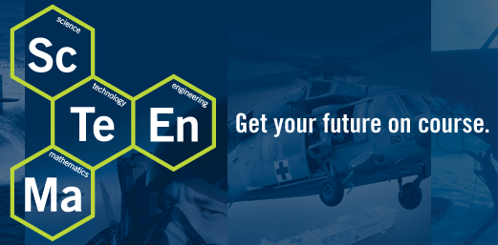
Nuclear Power
Clean, Safe, and Effective

Slide 2
Nuclear Power: Clean, Safe, and Effective

Slide 3
Nuclear Power Plants in America
Nuclear Power: Clean, Safe, and Effective

Slide 4
World Wide
Nuclear Power: Clean, Safe, and Effective

Slide 5
US 2014 Electricity Generation By Type
Nuclear Power: Clean, Safe, and Effective

Slide 6
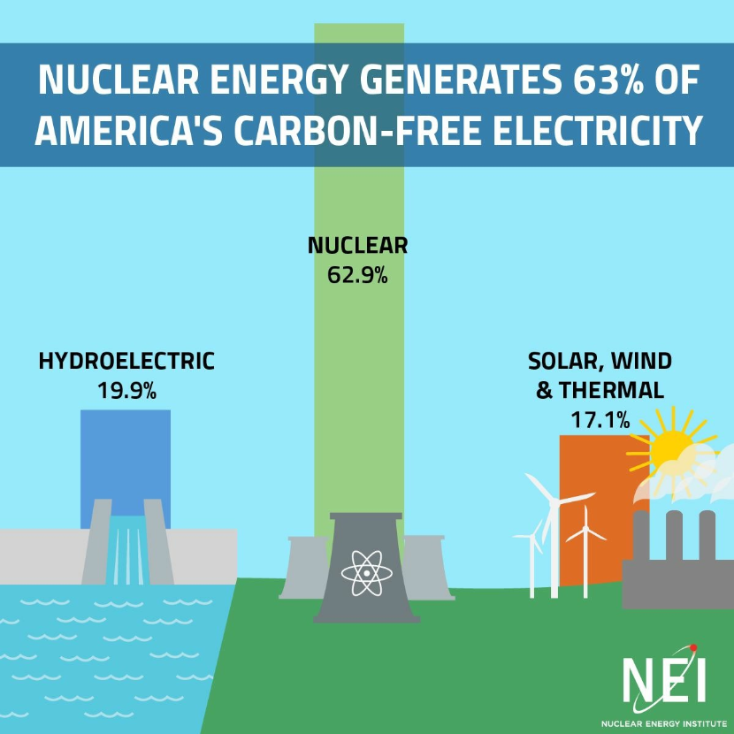
Nuclear Power: Clean, Safe, and Effective

Slide 7
Reducing The Carbon Footprint
Nuclear Power: Clean, Safe, and Effective

Slide 8
Top 10 Nuclear Generating Countries
Nuclear Power: Clean, Safe, and Effective

Slide 9
Fission vs Combustion
Fission
n + U235 => (U236)* => FF + FF + 2-5n’s + g + ENERGY
Combustion
CH4 + 2O2 => CO2 + 2H2O + ENERGY
Nuclear Power: Clean, Safe, and Effective

Slide 10
Atomic Stability
Very large atoms have too many protons and neutrons and become unstable
They can emit an alpha in an attempt to stabilize or they can fission
Fission occurs when the energy it takes to maintain the heavy nucleus is less than it takes to maintain 2 nuclei, in fact it takes so much less energy to maintain the 2 nuclei that some of the neutrons are no longer needed.
The more unstable a nucleus is, the more likely it is to fission either spontaneously or when bombarded by a neutron.
Nuclear Power: Clean, Safe, and Effective

Slide 11
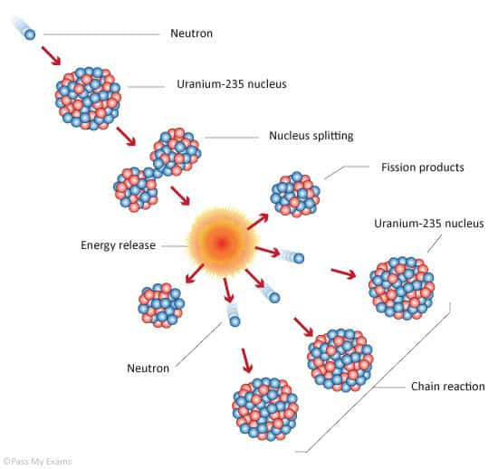
Chain Reaction
A neutron is about to hit the nucleus of a Uranium Atom.
The Uranium nucleus splits (fission) into several smaller atoms, releasing heat and several more neutrons.
The Chain Reaction begins: Those neutrons collide with other nuclei, causing more fission.
Nuclear Power: Clean, Safe, and Effective

Slide 12
Controlling the Reaction
Withdraw control rods,
reaction increases
Insert control rods,
reaction decreases
Nuclear Power: Clean, Safe, and Effective

Slide 13
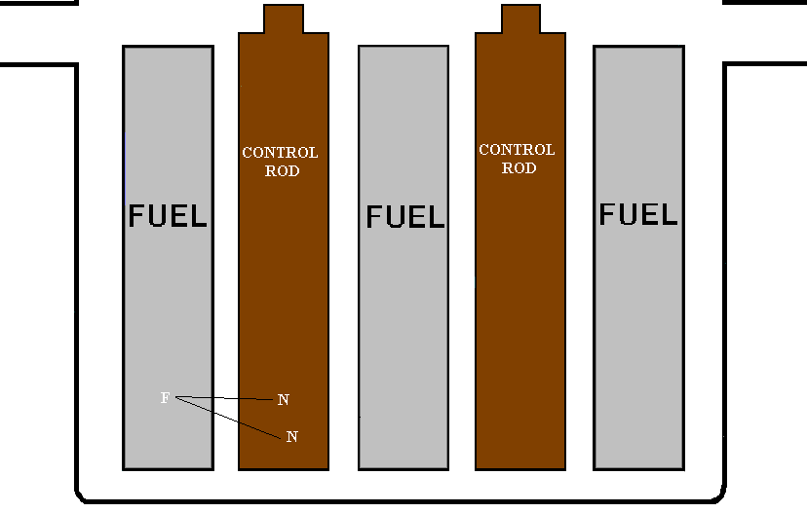
Controlling the Reaction
When the Control rods are inserted into the bottom of the reactor, all of the neutrons will be absorbed by the control rods, and the fission process is shut down.
The Control Rods are made of Hafnium. Each atom of hafnium can abosorb up to 6 neutrons.
Nuclear Power: Clean, Safe, and Effective

Slide 14
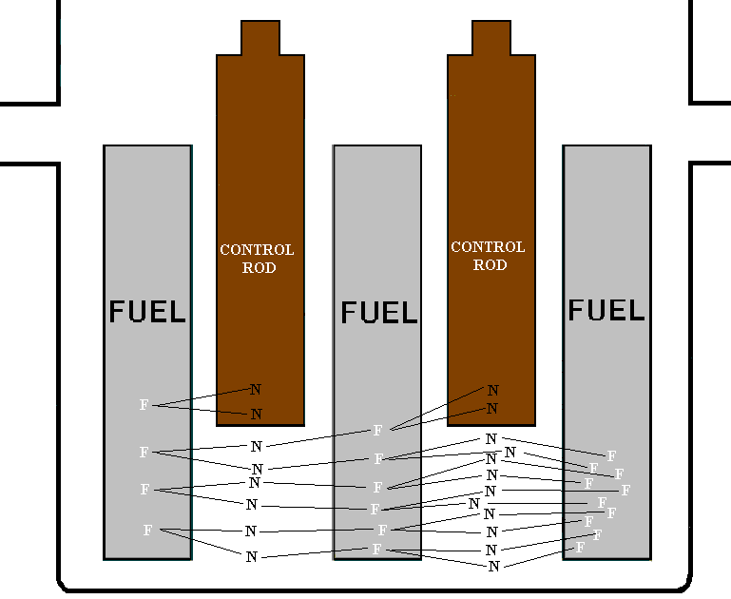
Controlling the Reaction
Control Rods are raised and lowered to control where the neutrons can cause fission. Below the control rods are allowed to cause fission.
At or above the bottom of the control rods, the neutrons are absorbed into the control rods and cannot cause subsequent fissions.
Nuclear Power: Clean, Safe, and Effective

Slide 15
Bang For Your Buck
1 Uranium Fuel Pellet weighs 10 grams or 0.35 oz or 0.02 lbs.
Nuclear Power: Clean, Safe, and Effective

Slide 16
Closer View
Nuclear Power: Clean, Safe, and Effective

Slide 17
Energy Required To Power A Light Bulb For 1 Year.
One light bulb requires 876kW-hr to be powered for one year.
It takes 714 lbs of coal to produce 876kW-hr
One gram of uranium produces 22,813 kW-hr
Enough to power a 100W light bulb for 26 years
Nuclear Power: Clean, Safe, and Effective

Slide 18
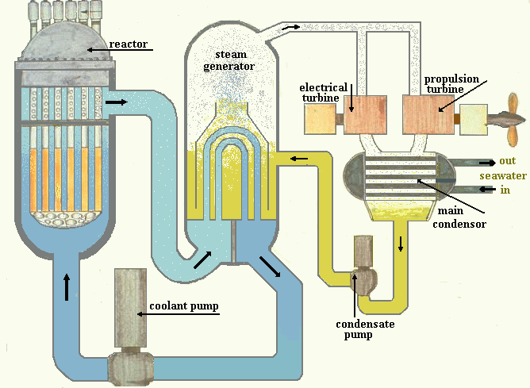
Navy Nuclear Reactor
Nuclear Power: Clean, Safe, and Effective

Slide 19
Putting It All Together
Nuclear Power: Clean, Safe, and Effective

Slide 20
In Real Life
Nuclear Power: Clean, Safe, and Effective

Slide 21
Nuclear Power Output
Nuclear Power: Clean, Safe, and Effective

Slide 22
Benefits Of Nuclear Power
Nuclear power plants emit far fewer atmospheric pollutants than the competition. They do not emit any sodium dioxide, nitrogen oxide or dust from burning fuel
Nuclear power plants only need to be refueled about once every year. The new store of fuel constitutes about 2 metric tons, or 6 truckloads of uranium. Coal power plants require a new trainload of about 100 tons of coal every day.
One nuclear power plant generates twice as much electricity in one month as a coal fired power plant generates in a whole year !!
Nuclear Power: Clean, Safe, and Effective

Slide 23
Myths About Nuclear Power
Myth # 1: Americans get most of their yearly radiation dose from nuclear power plants.
Truth: We are surrounded by naturally occurring radiation. Only 0.005% of the average American's yearly radiation dose comes from nuclear power; 100 times less than we get from coal, 200 times less than a cross-country flight, and about the same as eating 1 banana per year.
Myth # 2: A nuclear reactor can explode like a nuclear bomb.
Truth: It is impossible for a reactor to explode like a nuclear weapon; these weapons contain very special materials in very particular configurations, neither of which are present in a nuclear reactor.
Myth # 3: Nuclear energy is not safe.
Truth: Nuclear energy is as safe or safer than any other form of energy available. No member of the public has ever been injured or killed in the entire 50-year history of commercial nuclear power in the U.S. In fact, recent studies have shown that it is safer to work in a nuclear power plant than an office.
Nuclear Power: Clean, Safe, and Effective

Slide 24
Radiation Typed & Shielding
Nuclear Power: Clean, Safe, and Effective

Slide 25
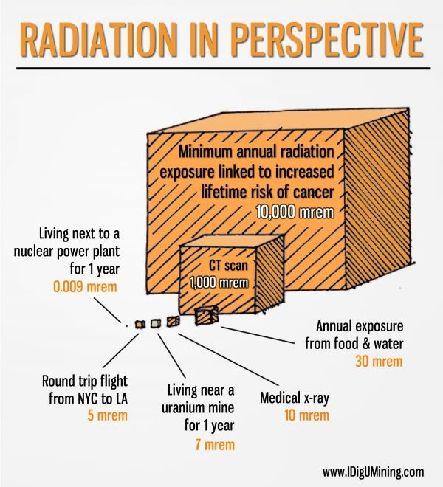
Radiation In Perspective
Nuclear Power: Clean, Safe, and Effective

Slide 26
What About The Waste?
Greater than 90% of the spent fuel material is recycled for use in subsequent batches of nuclear fuel.
Approximately 1 ton of actual NUCLEAR WASTE is generated per year that must be stored. We currently have a storage capacity available for about 5000 years !
Nuclear Power: Clean, Safe, and Effective

Slide 27
Navy Track Record
Currently operating 103 Nuclear Reactors worldwide, and with a history in excess of 50 years of operating Nuclear Reactors, the United States Navy has NEVER had a nuclear accident. WHY????
Nuclear Power: Clean, Safe, and Effective

Slide 28
The Man
Admiral Hyman G. Rickover (1900-1986)
64 years of NAVY service (1918-1982)
Polish Born
Father of the Navy Nuclear Power Program
Sold congress on Naval Nuclear Power
Nuclear Power: Clean, Safe, and Effective

Slide 29
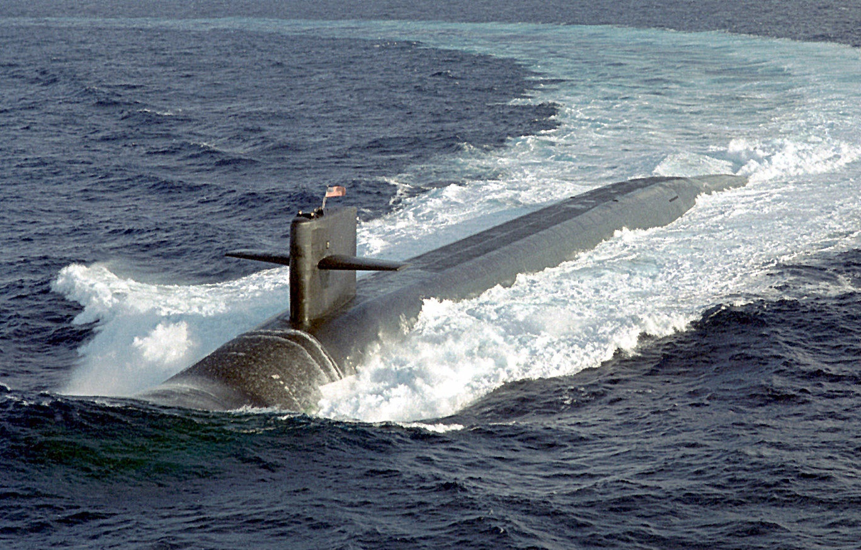
Nuclear Vessels
Nuclear Power: Clean, Safe, and Effective

Slide 30
Nuclear Engineering In The Navy!
Be a part of the most challenging and rewarding program the Military has to offer!
- Enlist at paygrade E-3 (Instead of E-1)!
$12,000 signing bonus!
- Courses taken in the Nuclear Training Process earn MIT level college credits toward a degree, up to 77 semester credit hours!
Full Tuition Assistance and Post/911 GI Bill(3 Years full tuition and housing) Licensing and certifications paid for by the Navy.
Get paid to go to school with housing provided and
- Best chance of being picked up for Officer Selection Programs (Naval Academy, ROTC, STA-21)!
- Reenlistment Bonuses of up to $100,000 after 2 years.
Nuclear Power: Clean, Safe, and Effective

Slide 31
Civilian Engineering Jobs
With The Completion Of An Engineering Degree After The Navy.
Chemical Engineer $94,350
Electrical Engineer $89,630
Mechanical Engineers $80,580
Nuclear Engineers $104,270
Information derived from the Occupational Outlook Handbook.
Nuclear Power: Clean, Safe, and Effective

Slide 32
Questions? Want More Info?
U.S. Department of Energy: www.doe.gov
“The Virtual Nuclear Tourist” website www.nucleartourist.com
Nuclear Regulatory Commission (NRC): www.nrc.gov
World Nuclear Association www.world-nuclear.org
Nuclear Power: Clean, Safe, and Effective

