Slide 1
New Accession Training Program

Slide 2
New Accession Training Program
Offers a candidate the opportunity to serve their country in a “part time” role, fulfilling a commitment of one drill weekend a month and a two week annual training that may give worldwide training opportunities.
Ideal for members who want to be close to home, attending college full time and need assistance with tuition.
Offer training opportunities in aviation, medical, intel, engineering , and admin.

Slide 3
Program Requirements
Must be a High School diploma graduate or equivalent
17-39 years old
Must qualify on the ASVAB (armed services vocational aptitude battery) test
Must meet moral, legal, and physical standards

Slide 4
Finances As A Reservist
Every Drill Weekend is divided into four 4 hour periods. Each period is worth one day of Active Duty Pay. This totals 48 drill periods per year.
Get paid for 4 days of Active Duty for only 2 days of work
Flexibility in drilling
Move where you want, when you want. (NAVY DOES NOT COVER RELOCATION COSTS)
Choose locations for orders, annual training, etc.
Notes:
MONEY: There is flexibility with when you can drill. A lot of Navy operational support centers will have alpha and bravo drill weekends so the NOSC is not overpacked and the NOSC staff is not overwhelmed.

Slide 5
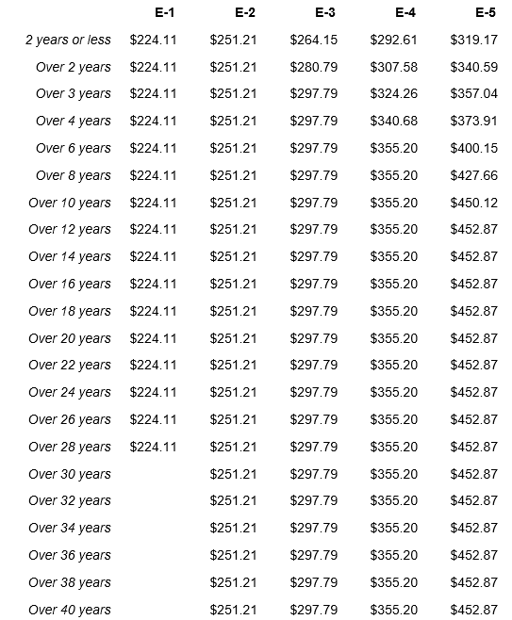
By the time a Sailor Finishes their first 6 years, they can be making $400/mo
just for the one weekend they show up.
Notes:
This is a snap shot of the most recent pay chart for a drilling reservist. A NAT sailor has the opportunity to make $400 per drill weekend after six years.

Slide 6
Reserve Retirements
BLENDED RETIREMENT SYSTEM
Allows YOU to be in charge of your retirement.
Automatic 1% contribution
Navy will match member up to 5% of contributions
Everything you invest, you keep; regardless of your military commitment
Notes:
The blended retirement system allows a servicemember to be in charge of their retirement. A lot of drilling reservist’s tend to use their drill pay to pay for their medical services and then deposit the residual amount into the blended retirement system. A reservist still has the ability to retire after 20 years as long as they meet certain requirements.

Slide 7
Reserve Benefits
Adventure and Travel Opportunities
Annual Trainings can send you to exotic locations like Hawaii, Thailand, Spain and Italy
Aircraft Carrier is the size of 5 football fields and has the capability to go through the roughest oceans
Community Service opportunities to create a long lasting impact locally
Recreation
Kayaking
Camping
Bike Rentals
Attraction Park Discounts
Notes:
Adventure/Travel:
During annual trainings, you have the opportunity to be a passenger on an Aircraft carrier or submarine, your ID card is your passport. No long waits to renew or obtain a passport. Some of the countries I’ve visited are Dubai, Singapore, Thailand, Philippines, Hong Kong, Spain, and Italy. Not doing anything over the summer and you’d like to spend a bit more time on active duty. GOVDelivery is an email system that provides notifications of existing opportunities for a member to be activated for certain exercises or missions happening all around the globe. All this is free all while earning a paycheck the entire time, obtaining training, and an opportunity to network with actual professionals in the workforce!
Recreation:
A show of hands who likes to play basketball, baseball, racquetball, go kayaking, or just go camping? Every navy installation will have a local MWR (morale, welfare, and recreation) office who provides equipment. They offer kayaks with life vests, tents with sleeping bags, even bikes with full head and fall protection for those who forgot how to ride a bike. They also offer discount on tickets to places like Disneyland, universal studios, and other attractions. You’ll have free access to bases where they have more than 1 gym with 2 basketball courts, a workout facility with treadmills, full sets of workout equipment, and a room designated for cardio classes.

Slide 8
Training Pipeline
NAT Sailors are identical to their Active Duty brothers and sisters until completion of their ‘A’ (apprenticeship) School.
Upon completion of “A” School, they come back to their local Navy Operational Support Center (NOSC) and can continue school or work.
All military uniforms are issued at Recruit Training Command (completely free), along with an ID Card.
Notes:
Training: New accession training sailors receive the technical knowledge to assist active duty personnel with critical missions around the world. They obtain training using state of the art equipment to learn how to repair aircrafts, provide medical care, repair weapons systems, etc. Obtaining certificates that can provide an upper hand when applying for local, state, and federal jobs.

Slide 9
Post 9/11 GI Bill
Reservists can earn this GI Bill benefit for qualifying Active Service by going on orders more than 30 days)
>90 days – <6 mo = 40% of Tuition and BAH
6mo - <12 mo = 50% of Tuition and BAH
12mo - <18 mo = 60% of Tuition and BAH
18mo - <24 mo = 70% of Tuition and BAH
24mo - <30 mo = 80% of Tuition and BAH
30mo - <36 mo = 90% of Tuition and BAH
36 mo = 100% of Tuition and BAH
Basic drill commitment does not count (i.e. drill weekends and annual training)
Notes:
EDUCATION: Go to school and get paid to do it!
BAH is basic allowance for housing. This will allow a member to be paid a certain amount of money for an advanced pay grade to take care of school expenses. The rate at which they are paid will be determined by how much total active duty time they have and the location of their school. For example, if you go to school in San Diego, for every 30 days of school attended you will be given $2,643 untaxed. This does not include the money to pay for tuition.

Slide 10
Montgomery GI Bill-SR
All NAT Sailors meeting Satisfactory Performance Qualify.
Upon receipt of a discharge from active duty form (DD-214, a sailor may enroll but must maintain satisfactory attendance at Drill.
No “buy in” required
Full Time = $368/mo = $13,248/36mo
¾ Time = $275/mo = $9900/36mo
½ Time = $183/mo = $6588/36mo
< ½ Time = $92/mo = $3312/36mo
Apprenticeship Training is $276/mo. for the first 6 months, $202.40 for the 2nd 6 months, and $128.80 for the remaining training.
Notes:
Reservists who do not have any active duty time accrued will qualify for the Montgomery GI Bill Selective reserve. You bring a DD214 to your school’s veterans affairs office to request this benefit. The cool thing about this program is it wont disqualify you for using FAFSA (free application for student aid) and other state financial assistance. When you do accrue active duty time, you can roll over into the POST 9/11 GI Bill that we talked about on the previous slide.

Slide 11
Post 9/11 GI Bill Qualifying Service
FTS
Presidential Recall
Mobilization (voluntary and involuntary)
CANREC (recruiting duty)
Active Duty for Special Work (ADSW)
Active Duty for Operational Support (ADOS)
Active Duty for Training (ADT)
Notes:
These are some of the most common ways for a member to increase their POST 9/11 GI bill entitlements.

Slide 12
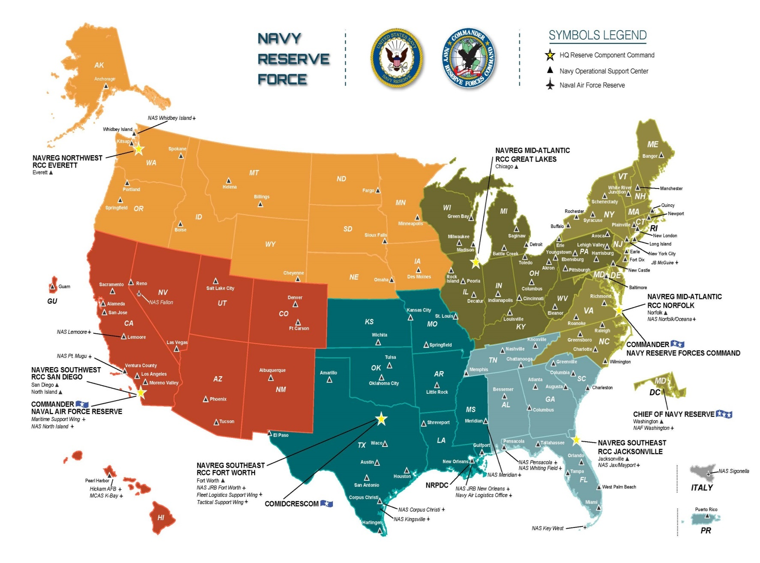
OCONUS:
ITALY, GUAM, JAPAN, GERMANY, SPAIN, ENGLAND
SUPPORTED BY NOSC JACKSONVILLE AND TAMPA
Notes:
Nationwide, here is a list of locations a NOSC is located. Let’s say a member decides to move halfway across the country, a lot of people think they are forever assigned to their NOSC. Not always the case. Moving in the SELRES is easy! Sailors will drill at the NOSC nearest their residence and are free to move at any time
*on their own dime*
Everything happens digitally before the move and the Sailor can drill forward to ensure they don’t miss any drill dates. *flexibility*
Berthing and meals are provided for Sailors living outside a 50 mile radius.

Slide 13
Tricare Dental/ Reserve Select
DENTAL PROGRAM:
-Member is $11.39/mo
-Member and Dependents is $85.44
TRICARE MEDICAL
-Member only is $42.83/mo
-Member + Family is $218.01/mo
Deductible E1-4: $51 member/ $102 family
https://tricare.mil/CoveredServices/Dental/TDP/Costs
https://tricare.mil/Costs/DentalCosts/TDP/CostShares

Slide 14
Drill Commitment
8 year Military Service Obligation with 6 year drilling obligation
1 weekend a month
4 hour periods. Drill Schedule given in advance to a member to make necessary arrangements
There is flexibility in when you drill; they can be moved around throughout the year as long as you complete the 40-48 periods by September 30th.
12 days annual training a year minimum, scheduled ahead of time with unit.
Locations: WORLDWIDE
2 years IRR (individual ready reserve) after 6 year drilling obligation Still on the radar but not required to drill.
Notes:
Security: There's a certain stability the Navy can provide that no other company can. We have no cutbacks or layoffs, we offer full retirement packages after 20 years of service and even have a retirement system you can invest into should you decide to leave the Navy earlier. Medical and dental is discounted and does not increase because you have another child. In comparison to a civilian who on average pays 300-500 for a family of 3 and this doesn’t include copays. These are everyday stressors a lot of civilians are not concerned with.

Slide 15
Reserve Component to Active Component (RC2AC/FTS)
NAT Sailors are ELIGIBLE to apply for active duty through the NOSC Command Career Counselor
Changes according to what the AC or FTS community manning is.
Job listings change every month and candidate must meet certain requirements.
Lateral change is effective almost immediately upon selection
Member will be issued orders to report at a certain date.
Notes:
Success:
A lot of people decide to try the reserves first because applicants think it’s a low risk investment. They can go active duty after they decide they want to serve their country in a bigger role. There are opportunities available. One way is to communicate with a Command Career Counselor of your intentions and they will see if there are openings for you to laterally cross over from the Reserve component to the Active Component. This again, offers flexibility a lot of other businesses cannot offer. You can achieve success as a reservist because you’ll network with professionals ranging from doctors to engineers and be given the opportunity to be recognized for certain achievements through awards.

Slide 16
RECAP
The NAT program gives flexibility to pursue a civilian career/college/family while still being a part of something bigger than yourself.
Boosts a civilian resume due to the military and free yearly on-the-job training, while also allowing you to pursue additional certifications through Navy Cool and civilian life.
Gives you a taste of what the Navy has to offer and opens the opportunity to go Active at any time through SELRES activation.
Notes:
Overall the New accession training program can provide an outlet for those who need a getaway from their everyday lives but also has the capability to enhance a person’s professional career. If you or someone else you know might benefit from this program please have them talk to me after class or call 1 800-USA-NAVY!

Slide 17
Thank you for the opportunity!
QUESTIONS?

