Slide 1
New Accession Training (NAT) & The Navy Reserve

Slide 2
Program Requirements
Designed to reduce critical Navy Selected Reserve (SELRES) manning shortfalls.
Must be HSDG or HSG
8 year MSO with 6 year drilling obligation

Slide 3
Training Pipeline
The training pipeline or NAT Sailors is identical to their Active Duty counterparts until completion of ‘A’ School (or ‘C’ School).

Slide 4
Drill Pay
Every Drill Weekend is divided into four 4 hour periods. Each period is work one day of Active Duty Pay. This totals 48 drill periods per year.

Slide 5
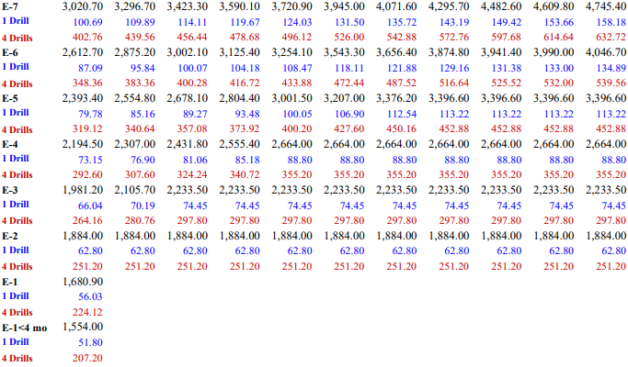
Drill Pay

Slide 6
Montgomery GI Bill-SR
All NAT Sailors meeting Satisfactory Performance Qualify.
No “buy in” required
Full Time = $368/mo = $13,248/36mo
¾ Time = $275/mo = $9900/36mo
½ Time = $183/mo = $6588/36mo
< ½ Time = $92/mo = $3312/36mo
Apprenticeship Training is $276/ mo for the first 6 months, $202.40 for the 2nd 6 months, and $128.80 for the remaining training.

Slide 7
Post 9/11 GI Bill
Reservists can earn the Post 9/11 GI Bill for qualifying Active Service.
>90 days – <6 mo = 40% of Tuition and BAH
6mo - <12 mo = 50% of Tuition and BAH
12mo - <18 mo = 60% of Tuition and BAH
18mo - <24 mo = 70% of Tuition and BAH
24mo - <30 mo = 80% of Tuition and BAH
30mo - <36 mo = 90% of Tuition and BAH
36 mo = 100% of Tuition and BAH

Slide 8
Post 9/11 GI Bill Qualifying Service
FTS
Presidential Recall
Mobilization (voluntary and involuntary)
CANREC
Active Duty for Special Work (ADSW)
Active Duty for Operational Support (ADOS)
Active Duty for Training (ADT)

Slide 9
Post 9/11 GI Bill Qualifying Service
IDT (Drill weekends) and Annual Training (AT) do NOT count as qualifying service.
Initial Active Duty for Training (IADT) pipeline does NOT count for Post 9/11 qualifying service until members aggregate more than 24 months of total qualifying service.

Slide 10
Other Education Benefits
NO TA!
NO USMAP!
Training pipeline Joint Service Transcripts (JST’s) count as college credits.
Reserve Sailors do qualify for:
NAVY COOL
CLEP TESTS
CREDENTIALING AND CERTIFICATIONS

Slide 11
TRICARE RESERVE SELECT
Member only is $47.90/mo
Member + Family is $210.83/mo
Regardless of number of dependents

Slide 12
TRICARE RESERVE SELECT COPAYS
Ambulance services is 15%
Ambulatory Surgery is $25
Behavioral Health (Inpatient) is $20/day
Behavioral Health (Outpatient) is 15%
Preventive Services
Free shots
Free child visits until age 6
Free Cancer Screenings

Slide 13
TRICARE RESERVE SELECT COPAYS
Other Preventive and Emergency Services are 15%
NO BALANCE BILLING

Slide 14
Dental Costs
Member is $11.68/mo
Member and Dependents is $34.68/mo
Free Preventive Care
Various Copays

Slide 15
Satisfactory Participation Requirements
Attend 40 of 48 drills per year
Need to notify COC if missing any scheduled periods
Perform 12 days of AT each fiscal year
Earn 65 points per year

Slide 16
Moving in the Reserves
Moving in the SELRES is easy!
Sailors drill at the NOSC nearest their residence and are free to move at any time.
Sailors often drill away from their hard billets (UMUIC). We call this being cross-assigned out.
Berthing and meals are provided for Sailors living outside a 50 mile radius.

Slide 17
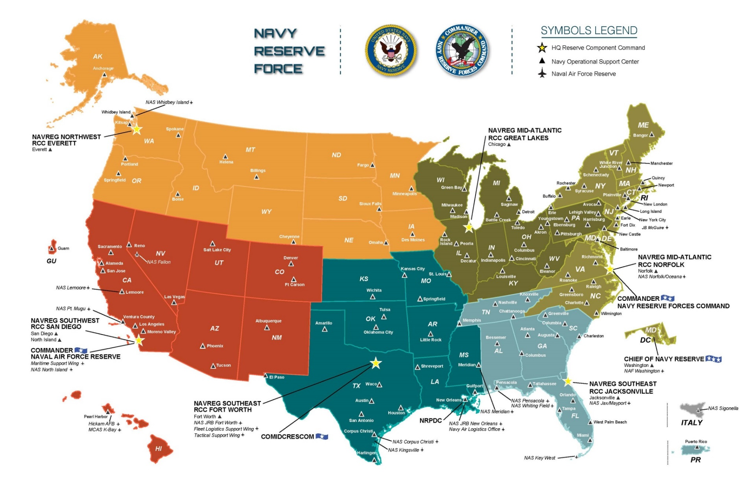

Slide 18
Reserve Retirements
After serving an aggregate of 20 satisfactory years in service, SELRES Sailors qualify for a reserve retirement.
Reserve retirements are based on pay-grade, years of service, and the number of retirement points earned.
Points are earned through: Drill Periods, AT, Active duty, Funeral Honors, Unpaid Special Events, Correspondence courses, and 15 free points per year.

Slide 19
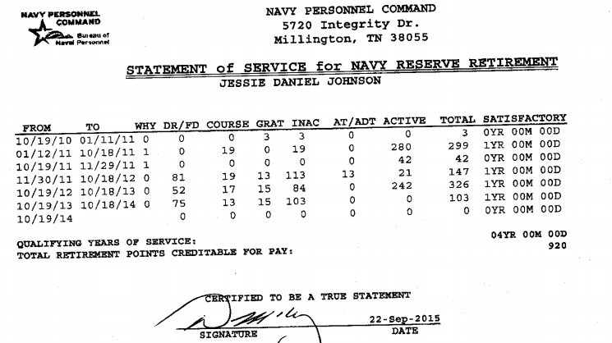
Point Capture

Slide 20
Expected Retirement Pay
A reservist who completes 20 years of Naval Service doing the minimum obligation can expect to earn around 1000 points and retire as an E-6. This would equal roughly $260/mo.

Slide 21
Expected Retirement Pay
A reservist who completes 20 years of Naval Service doing over the minimum obligation (factoring in 1 deployment and additional ADT/EAT time can expect to earn around 2055 points and retire as an E-7. This would equal roughly $680/mo.
https://www.hrc.army.mil/calculators/retirementcalc.aspx

Slide 22
Deployments
NAT’s receive a 2 year deployment deferment after returning from their IADT training pipeline to establish themselves in the community. This can be waived if they want to deploy.
NAT Sailors wishing to deploy can do so easily by clicking the links to deployment email advertisements.

Slide 23
RC2AC
NAT Sailors are ineligible to get a DD-368 and process for active duty through a recruiter until they have drilled for 2 years.
NAT Sailors are eligible to transition to active duty through the RC2AC program provided they meet rate and year group requirements.
http://www.public.navy.mil/bupers-npc/enlisted/community/selres/Pages/EnlistedReserveOpportunities.aspx

Slide 24
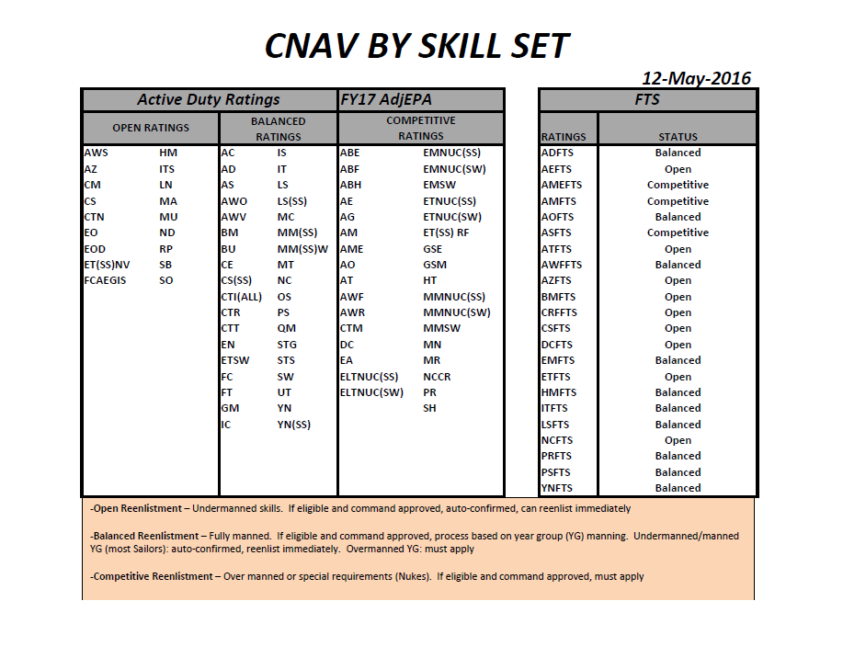
Active Duty CNAV Manning

Slide 25
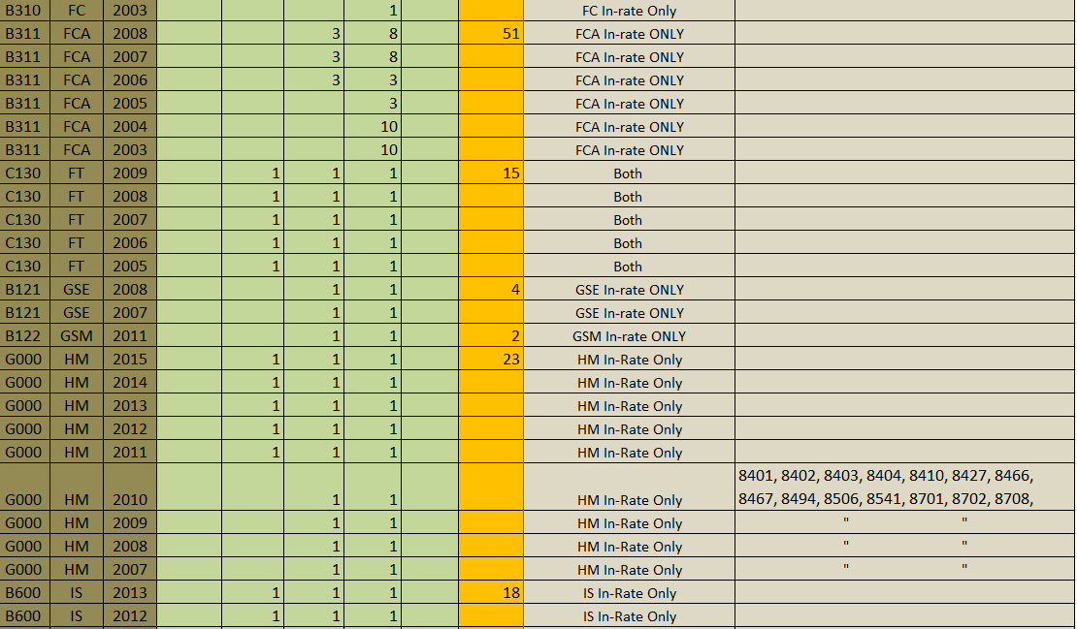
RC2AC Quota Listings

Slide 26
RC2AC Notes
Reserve Sailors Active Duty Service Date (ADSD) changes daily unless they are on active duty orders.
The Year Group Calculation for the RC2AC program is based on a Sailors ADSD.
NAT Sailors who are in the reserves long enough will pick up higher rank, but their year group will be close to the date they apply – they do not have experience. They often do not meet year group requirements because of this!
It’s a catch 22. It is easy to get trapped in the Reserves.

Slide 27
Questions?
Check out the Navy Reserve Homeport for the best references!

